Slide 1
Predeployment Information
Please read the following information before using the VCS app for the first time
VCS is a secure alerting and messaging app to support communication in the clinical setting. You are provided access to the VCS app on an NHS Lothian mobile device known as the Myco3 (see attached Myco3 instructions). The following points should be noted before logging in to VCS for the first time:
VCS is a communication tool only and does not replace the patient record. All care information should continue to be recorded as per current protocols
NHS Lothian Myco3 devices MUST be used at all times when using the VCS app
Please read NHS Lothian Mobile Device Policy (below) for security guidance:
Mobile Computer Devices including Laptops, Tablets, Phones, Wireless Devices and Removable Media v2.0.pdf (scot.nhs.uk))
All data is stored for auditing purposes. Data can be retrieved to support service improvement and incident management.
VCS will be used for all requests to Plastic Surgery from St John’s Hospital Emergency Department and Western General Hospital Minor Injuries Unit for the duration of the trial. The trial will start at 0800hrs on Tuesday 19th September 2023 and run for approximately 4-6 weeks.
This trial is part of a larger scale scoping exercise which is piloting 3 different apps to see which app best fits the organisation’s needs. Following all 3 trials, one of the apps will be chosen to replace the current pagers. The project team encourage user feedback about the positives, negatives and suggestions for improvement, please email emma.x.park@nhslothian.scot.nhs.uk with any feedback or alternatively contact clinical leads.

Slide 2
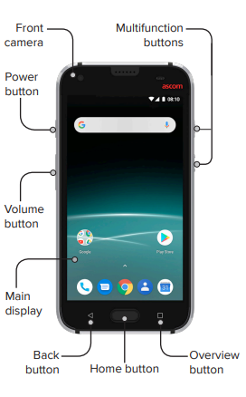
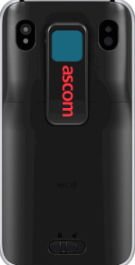
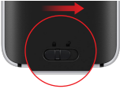
Myco3 Handset
Hot swap battery
To change the battery, slide along the lock button, remove the old battery, insert the new battery and slide back along to lock into place.

Slide 3
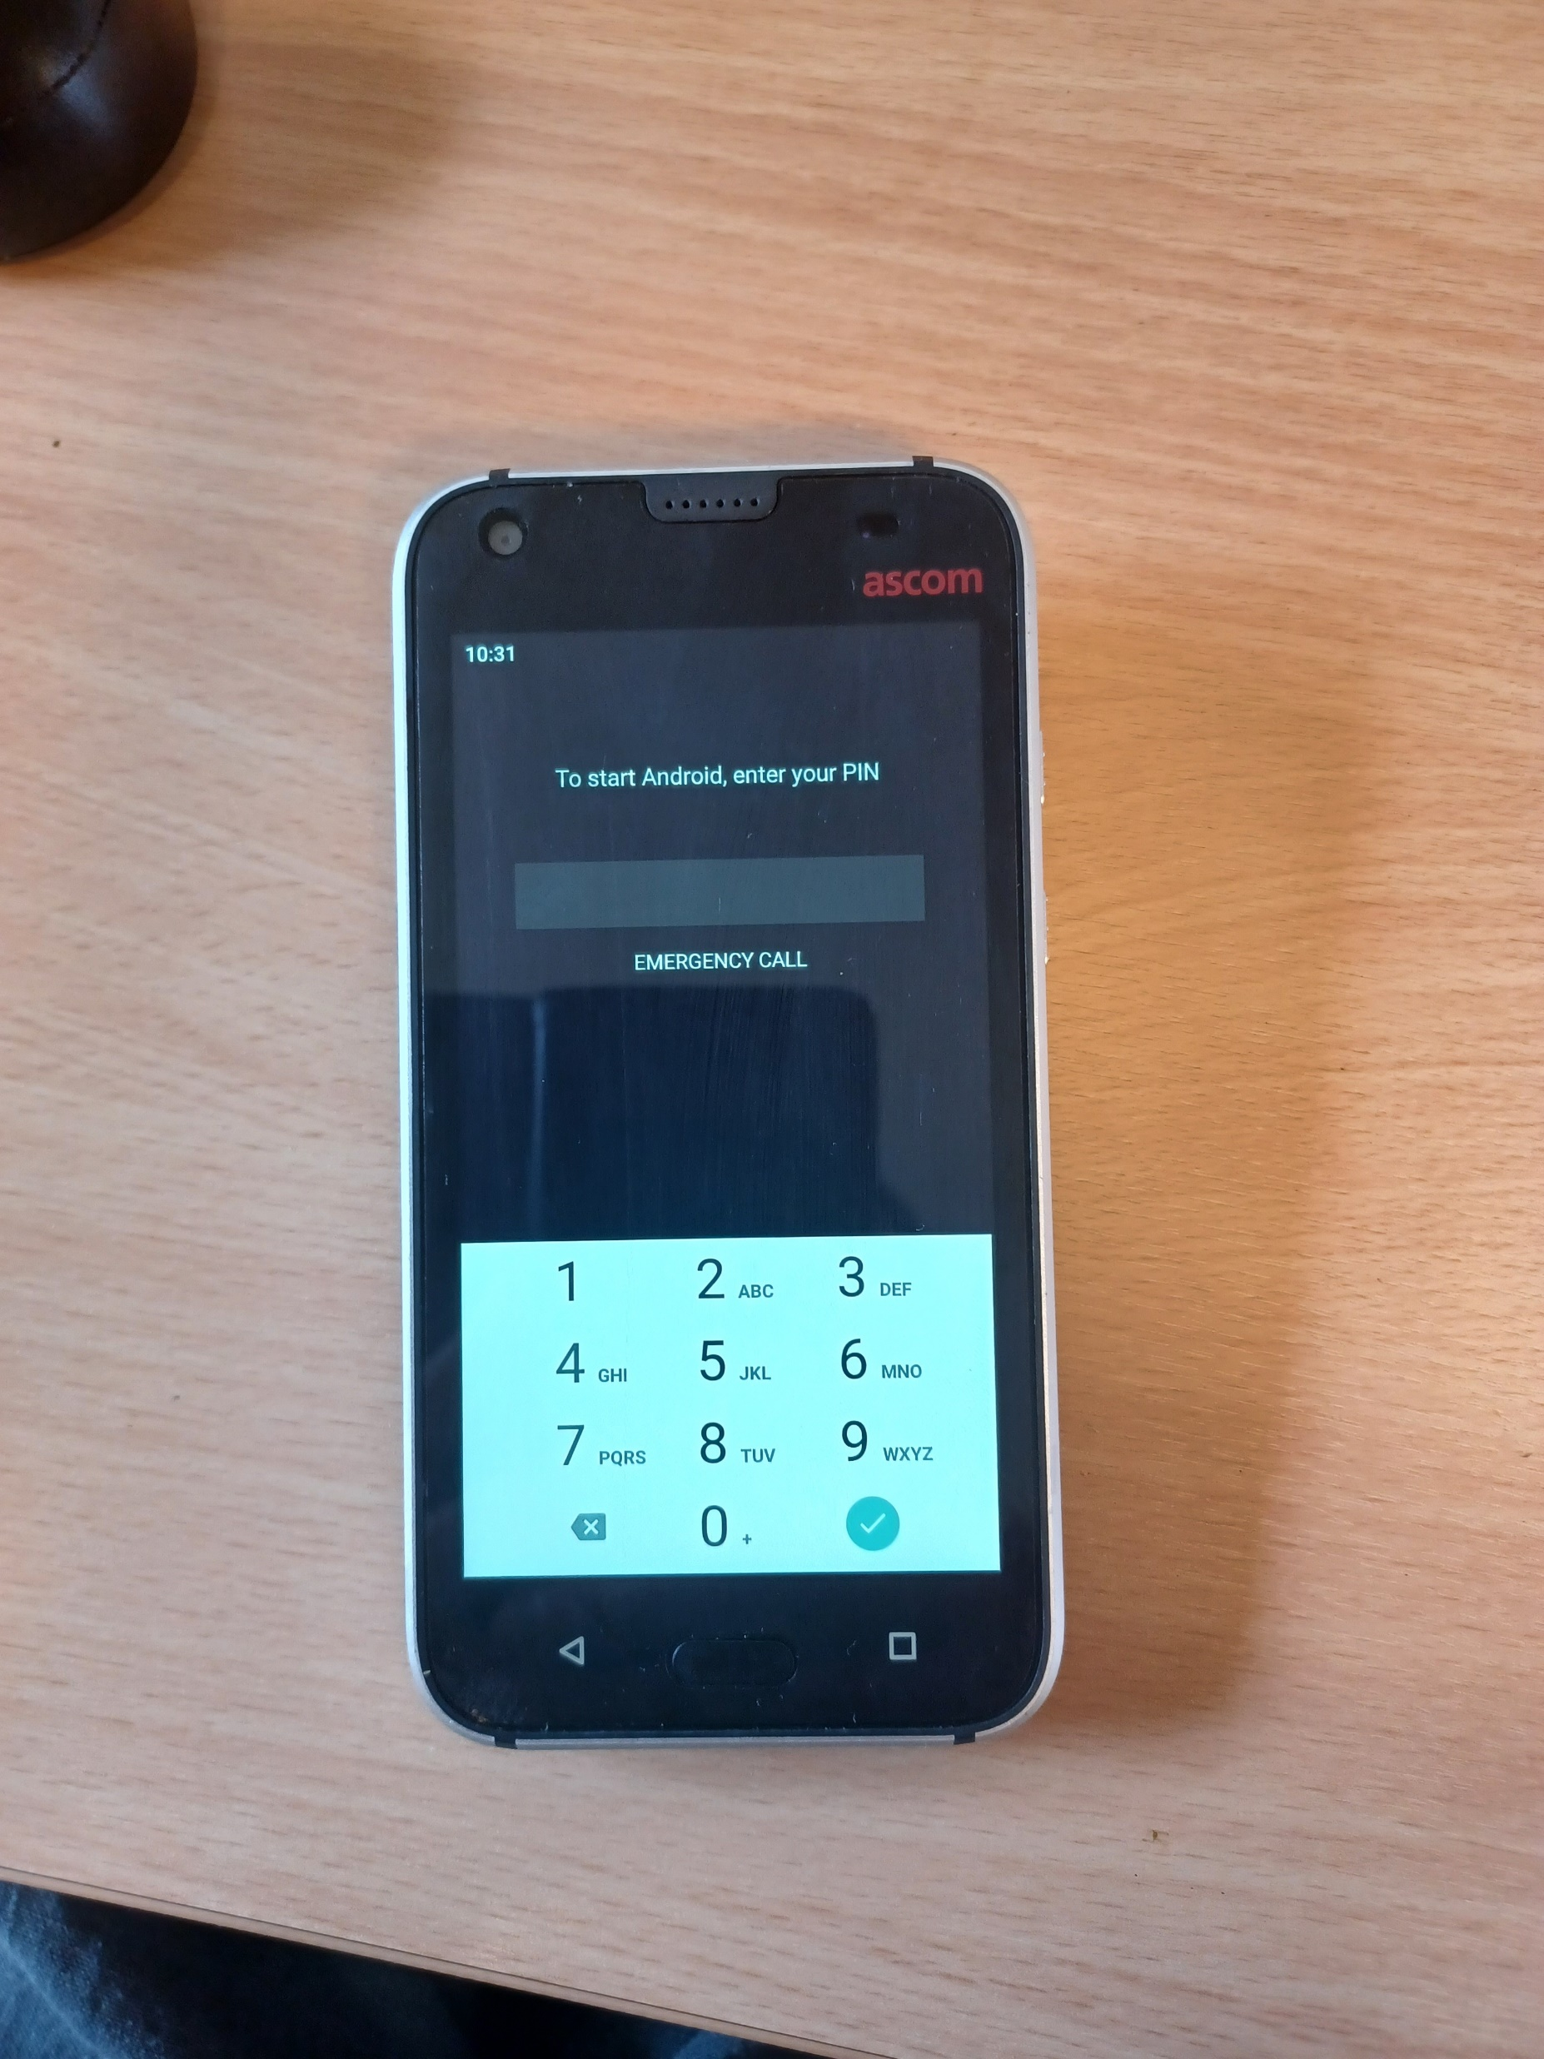

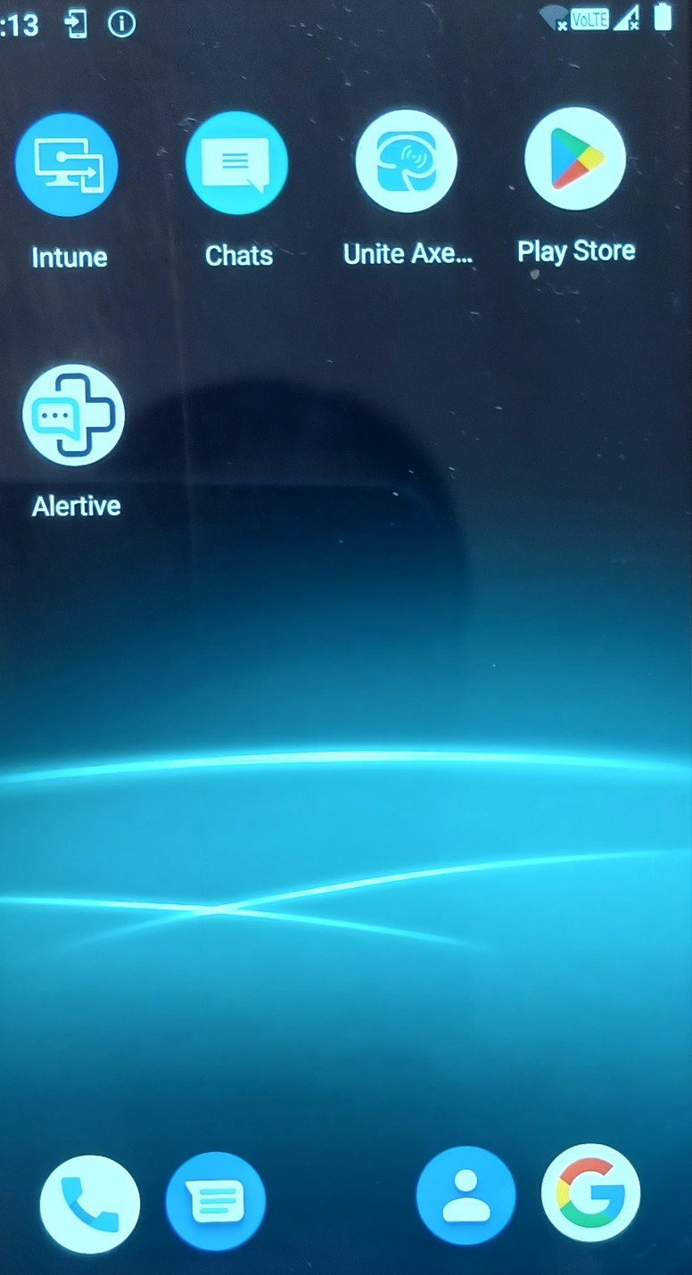
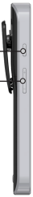

Turn on/off and screen navigation
To activate the handset press the power button and swipe up.
Enter the Lothian device pin code (12369874) and press ‘accept’
Power button
‘press and hold’ to switch on/off
Navigate between screens by swiping up/down/right/left
Volume

Slide 4
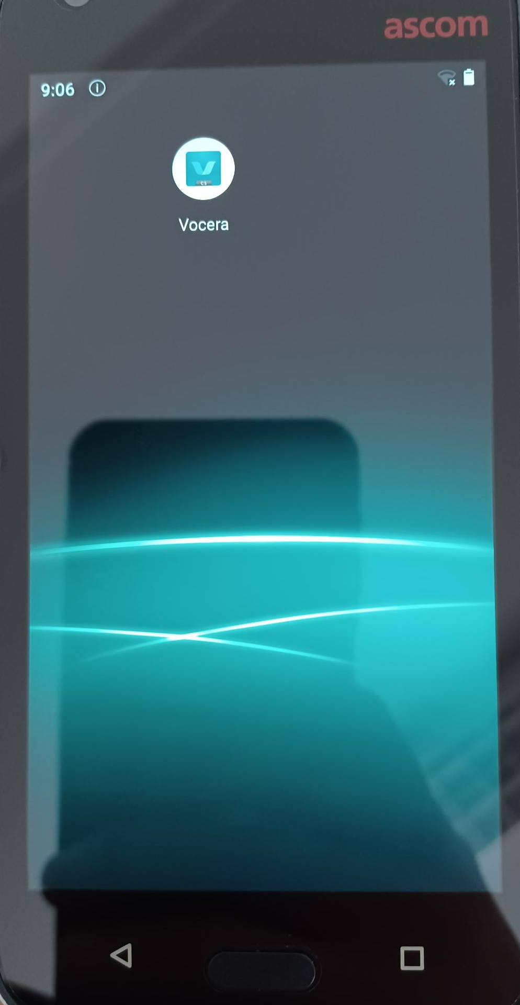
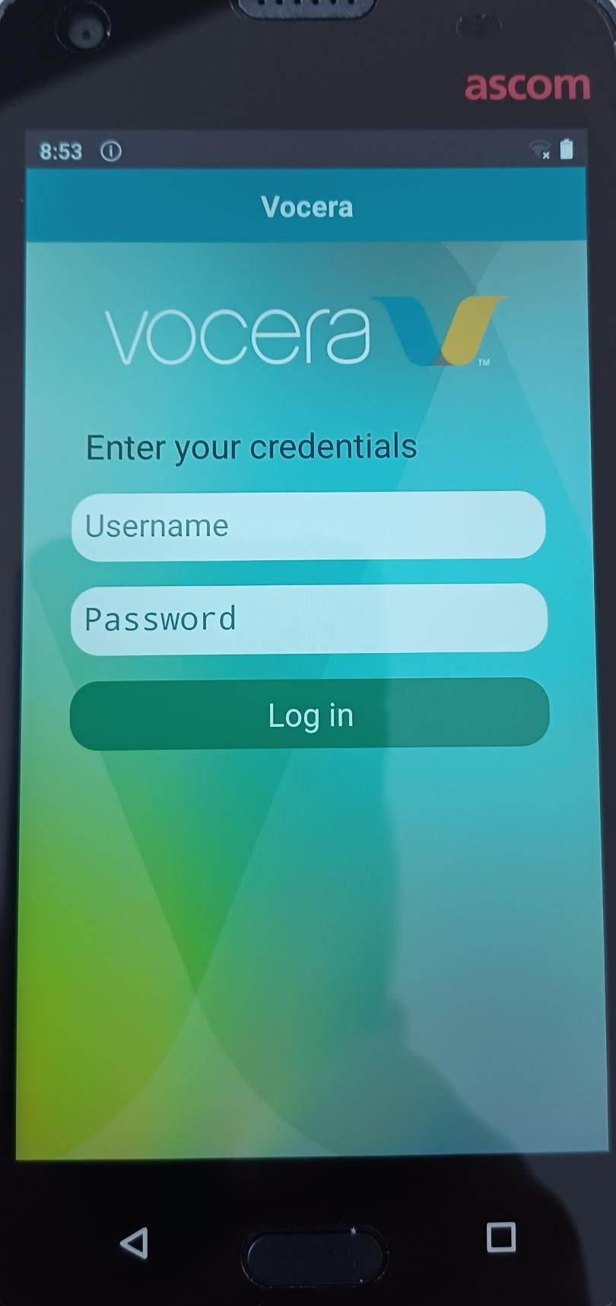
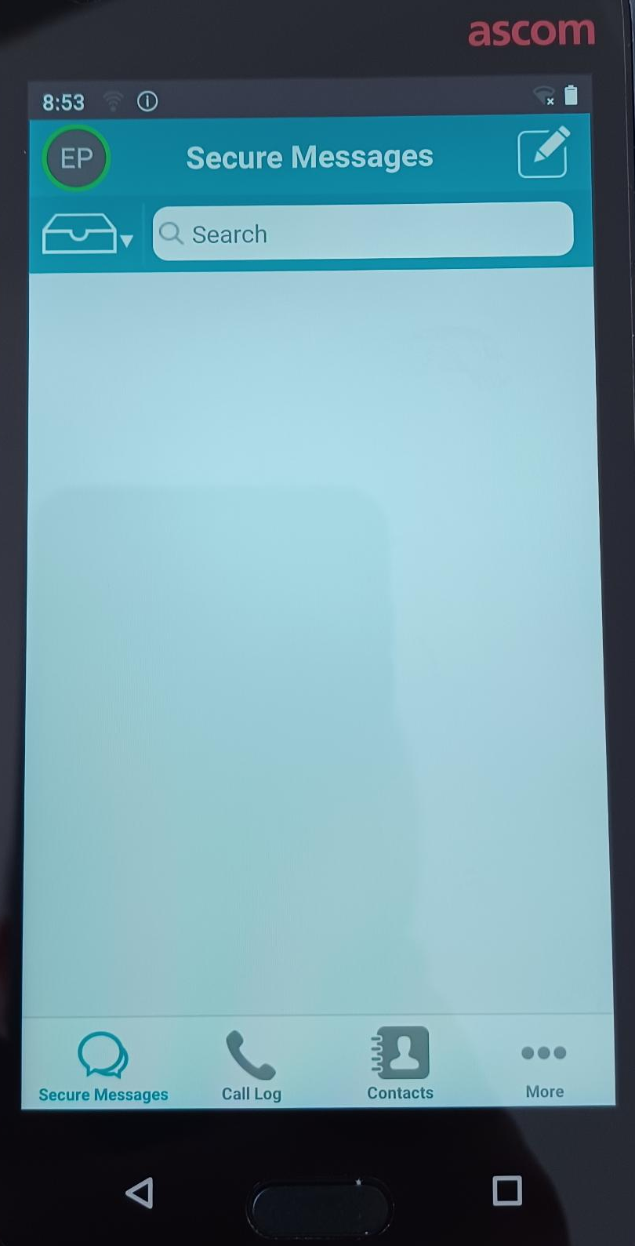
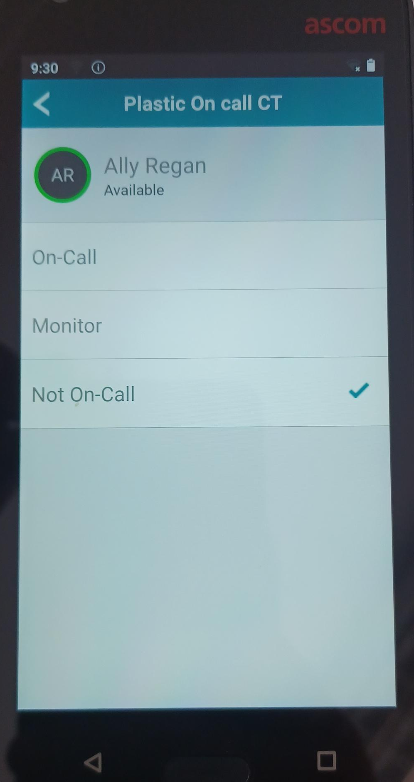
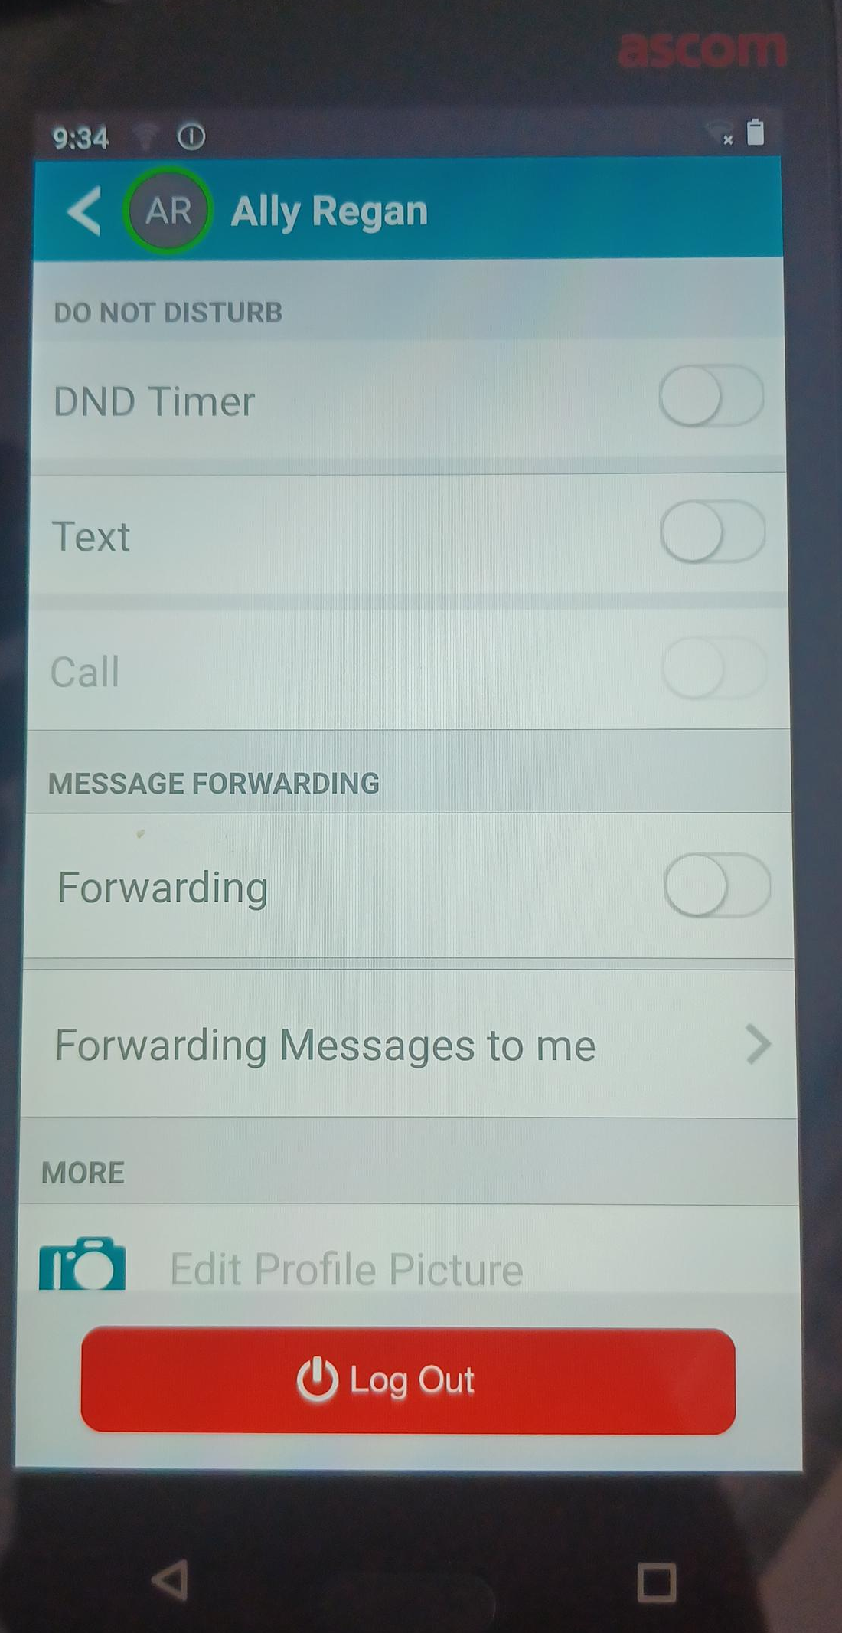
Logging in
Home screen
*Logging out
Select the VCS app from the Myco3 home screen
Enter your username and password then select ‘Log In’
Username: First name.Surname
Password: Surname
Please note, if your surname is less than 5 digits your password will be your surname followed by exclamation mark(s) to create a 5 digit password
3 dots gives your more options including on-call status
*Before logging out ALWAYS remember to change your status to ‘Not On-Call’
After logging in select your on call status from ‘My On-call Groups’ menu (see overleaf).
At the end of your shift select ‘Not-On-Call’ before logging off from the app
Select your icon at the top left of the app home screen to log out

Slide 5
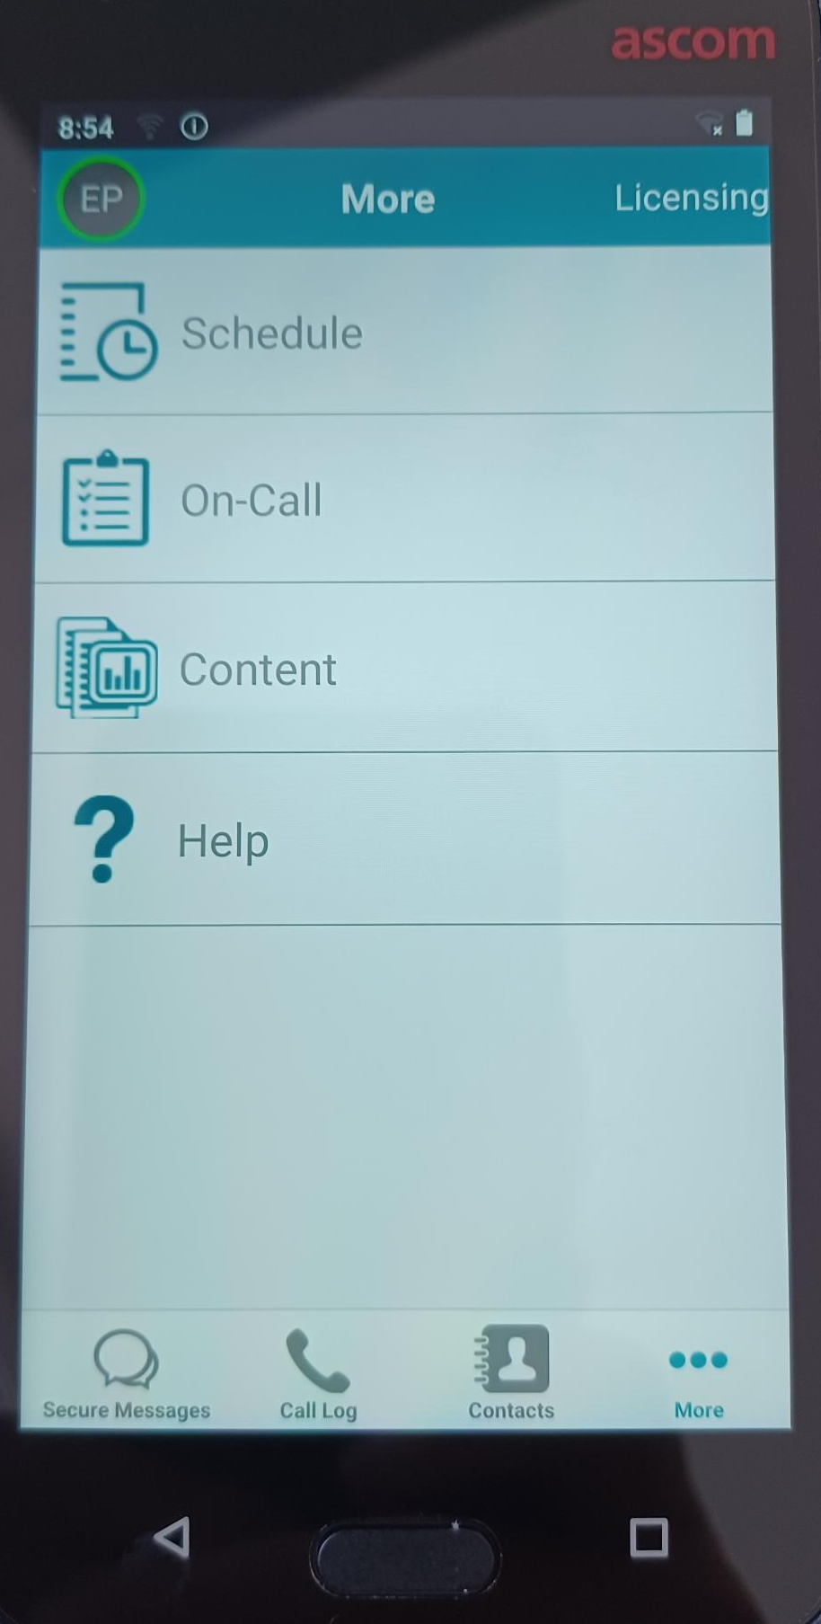
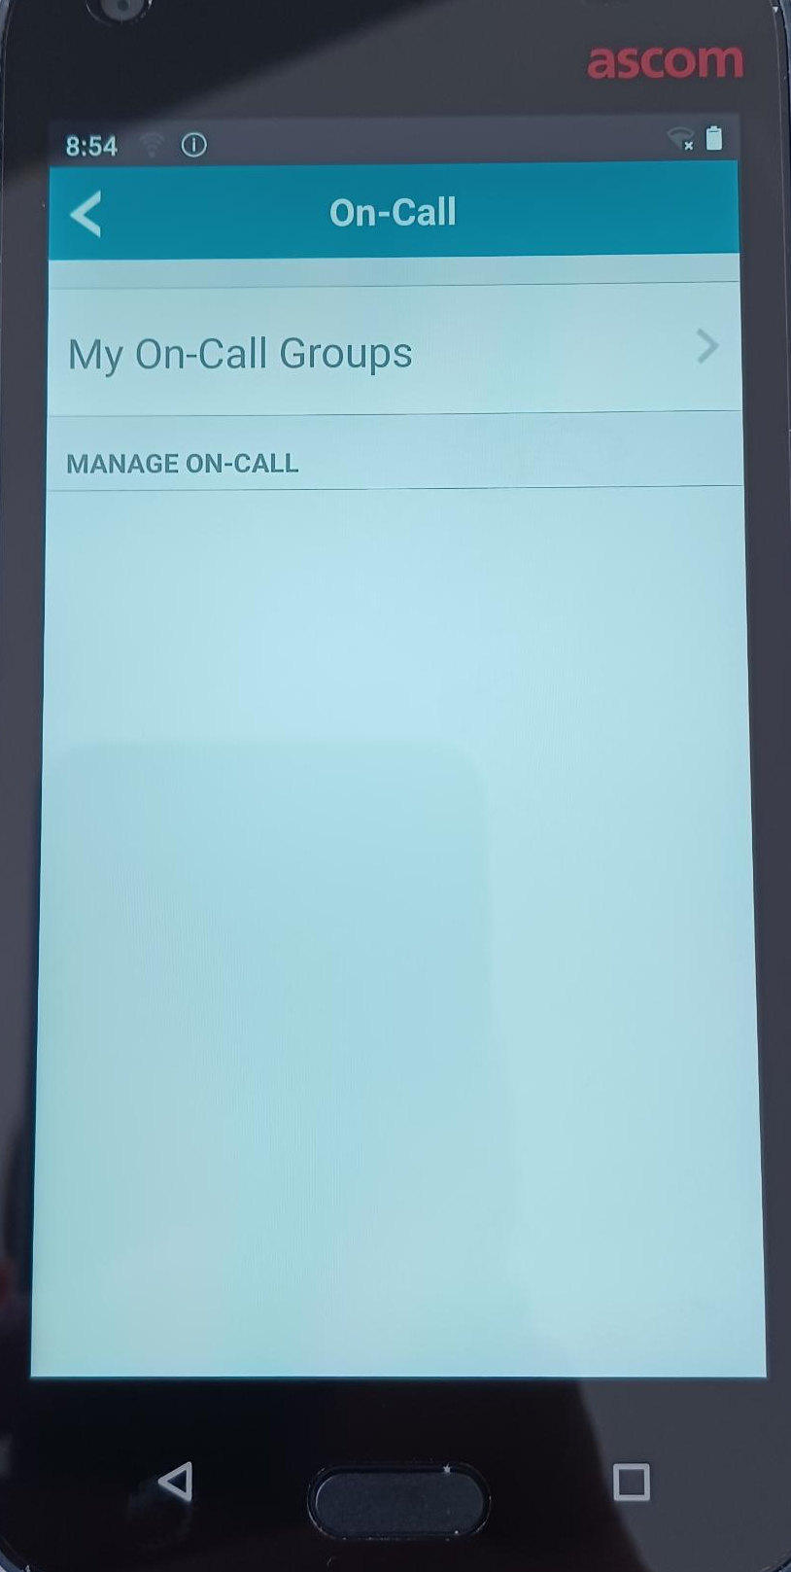
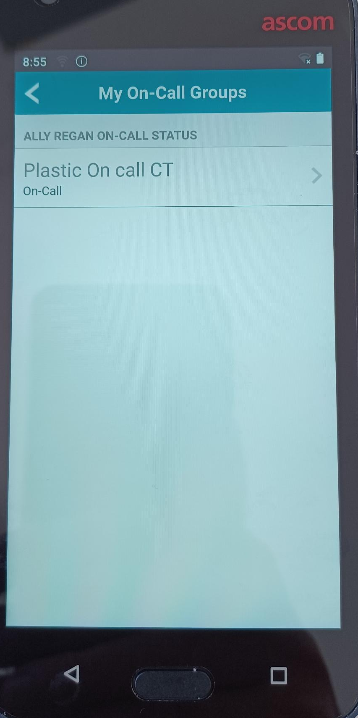
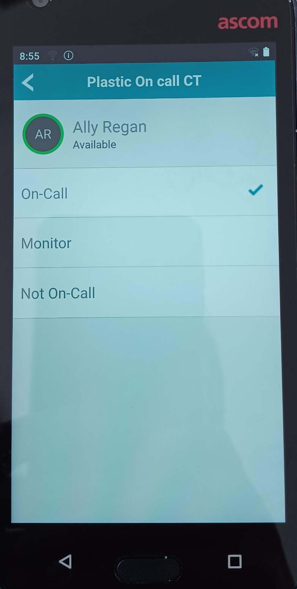
Start of shift procedure
From the app home screen, select the more options icon at the bottom right (3 dots)
Select the second option ‘On-Call’
Select ‘My On-Call Groups’
Select the on-call role you are performing (eg MIU ENP, MIU Physio, SJH ENP etc.)
Select ‘On-Call’ then select the return arrow at the top left to return to the app home screen
Remember to select ‘Not On-Call’ before logging off at the end of your shift.

Slide 6
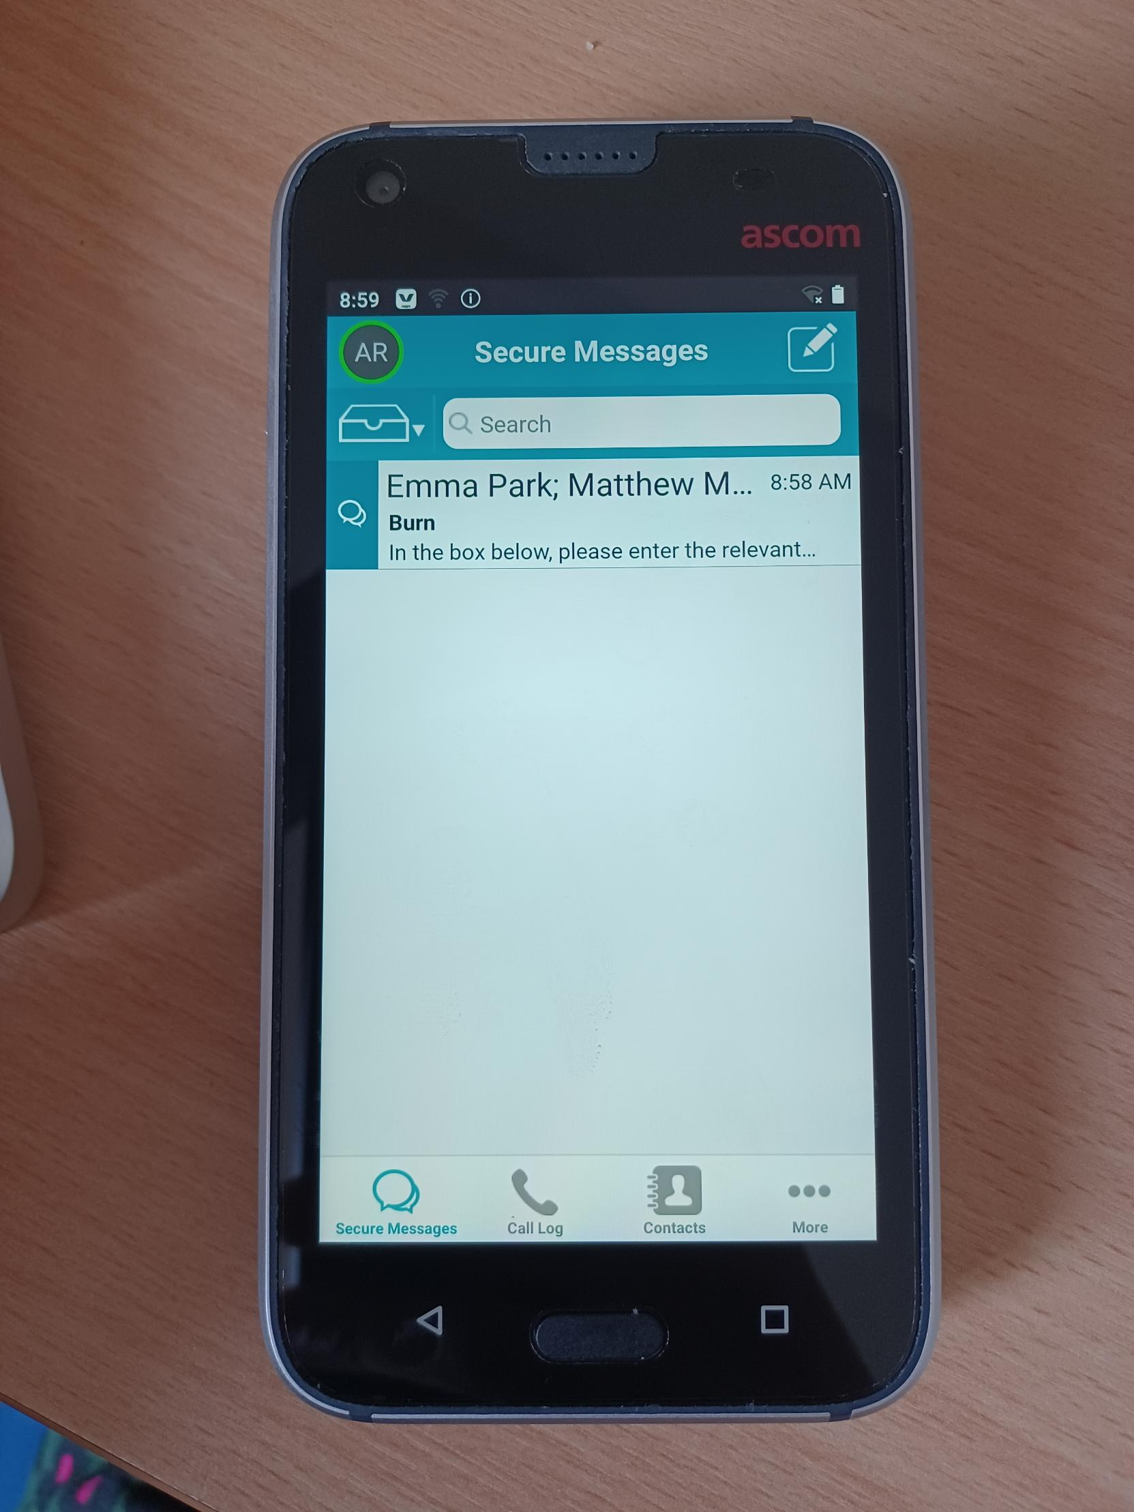
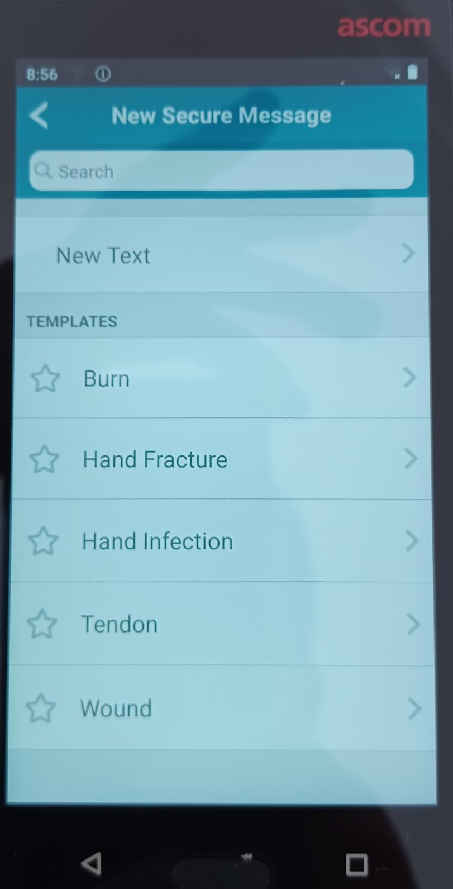
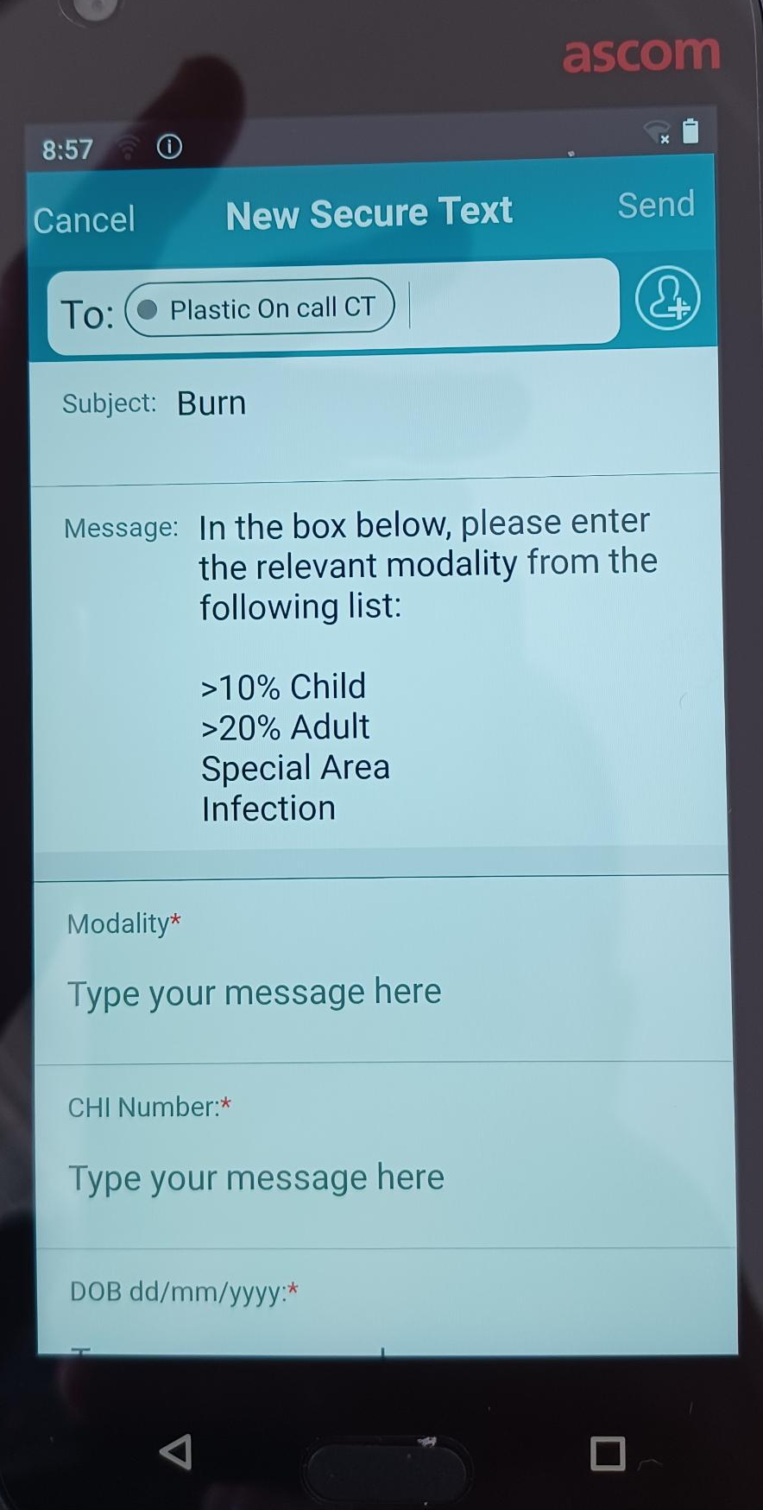
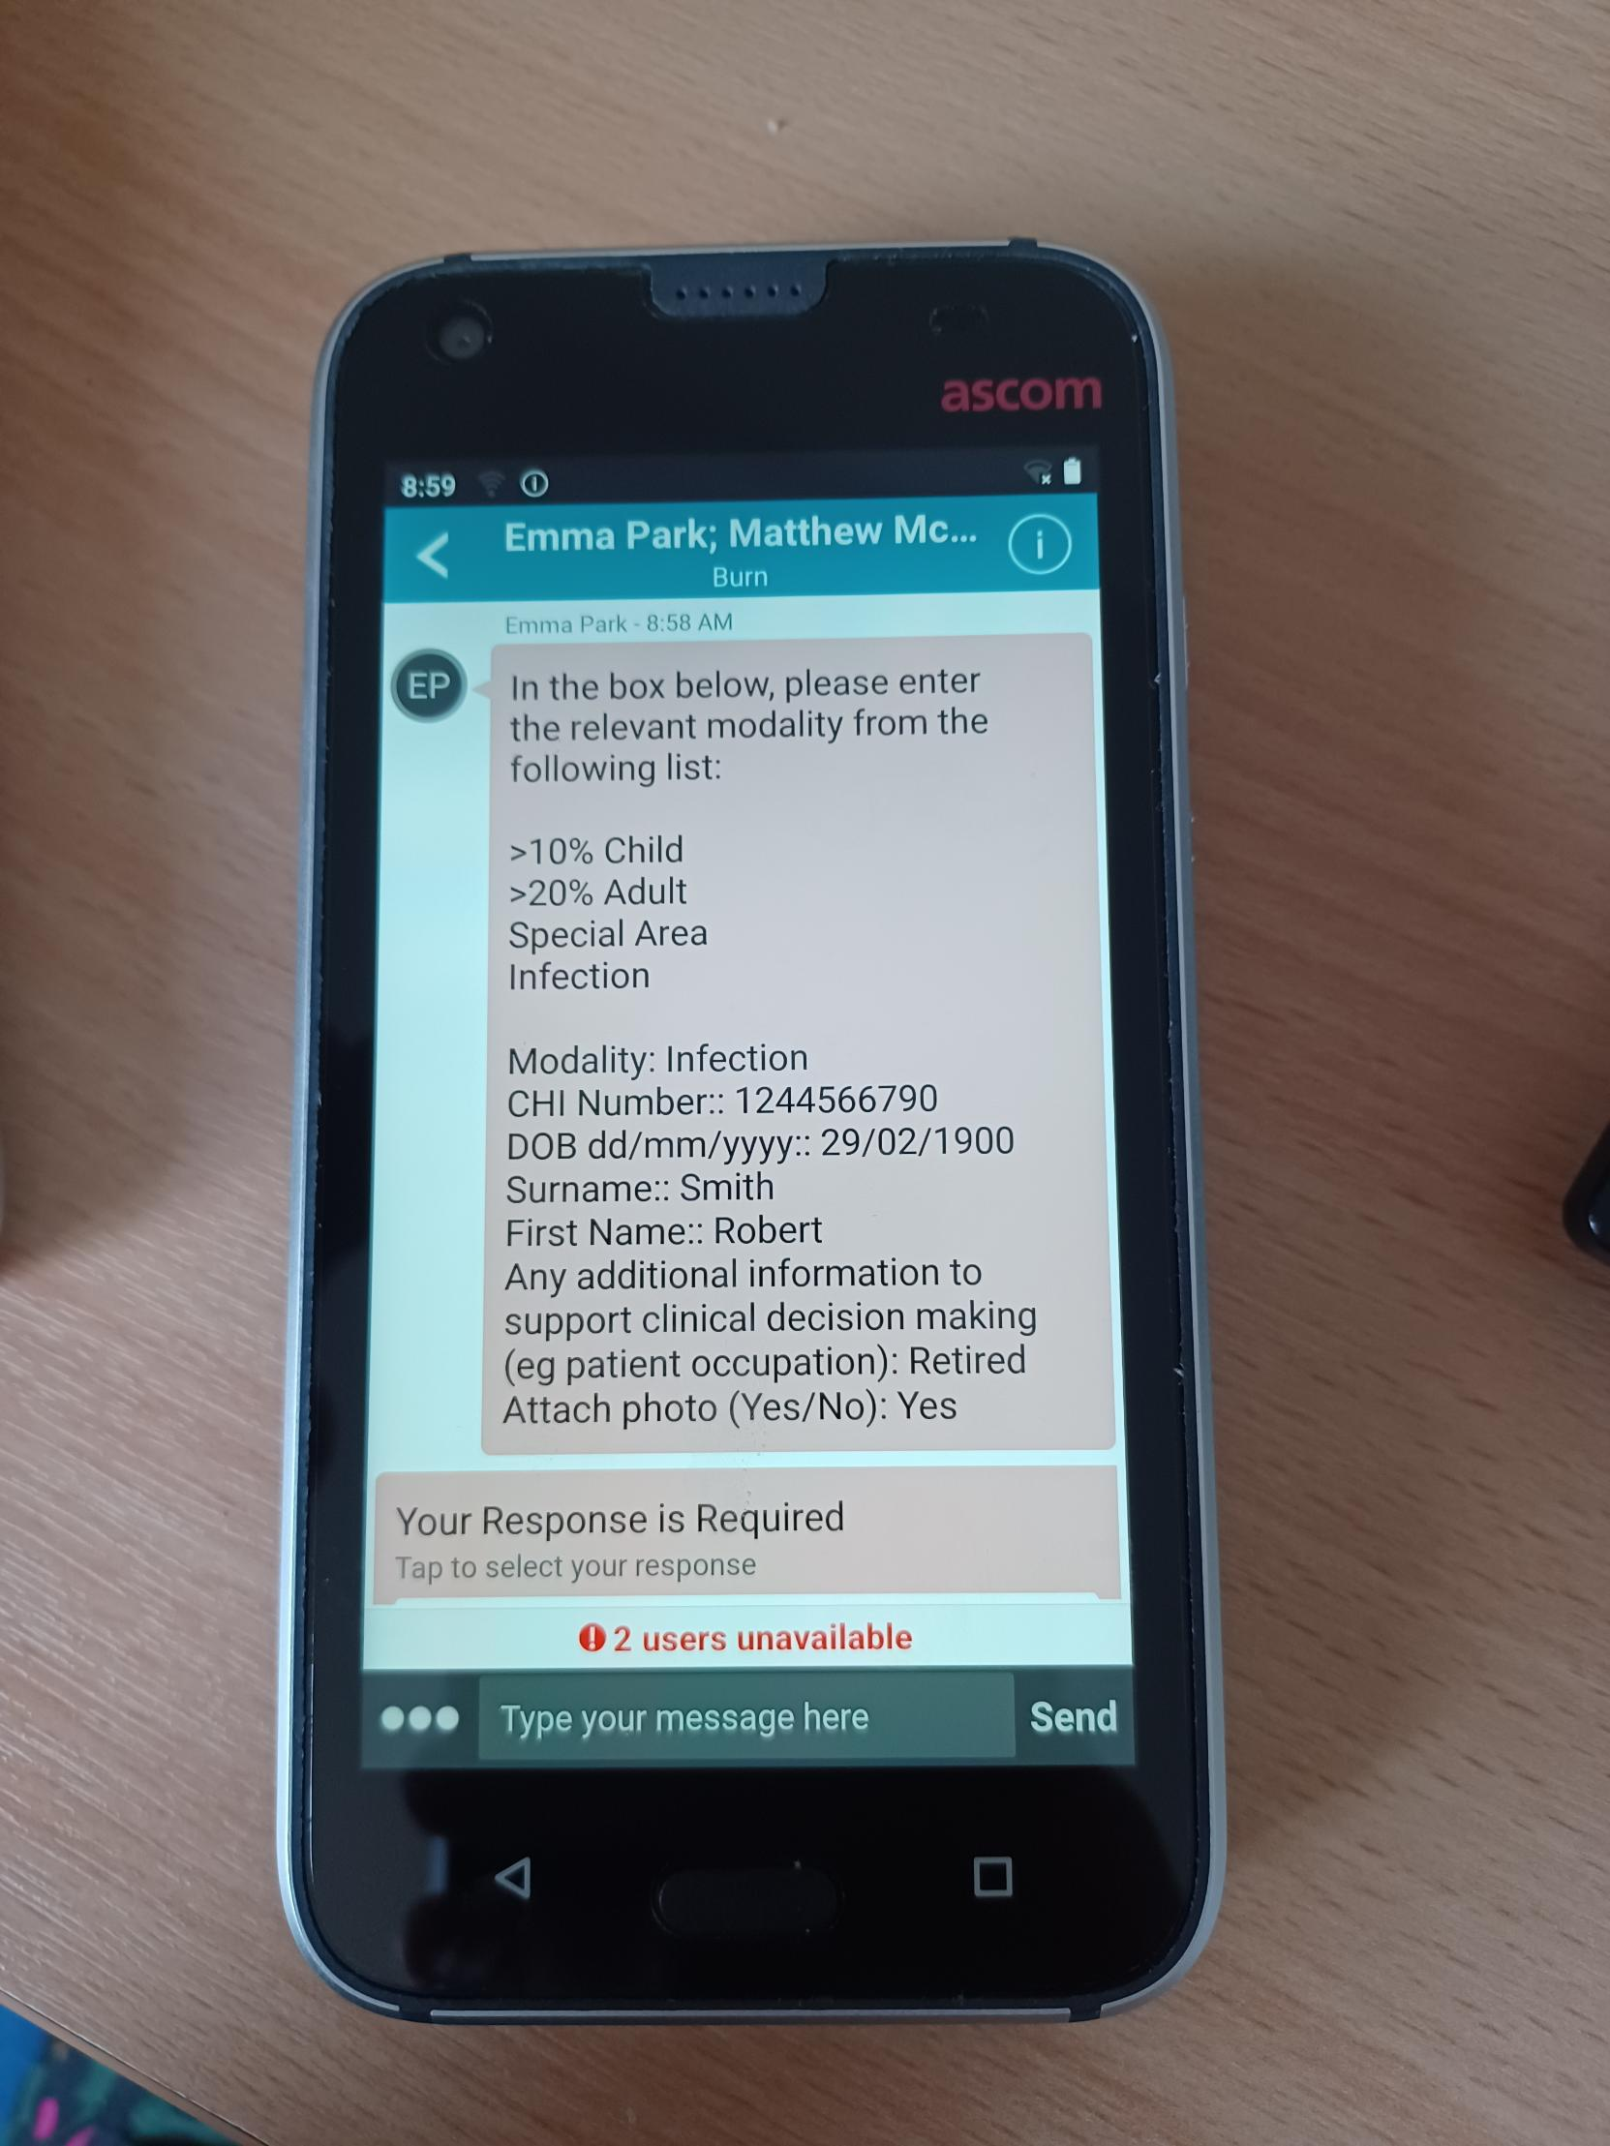
Sending a referral message
From the app home screen select the new message option (pencil icon)
This is the referral menu screen. Select the correct option
Complete the form with requested patient information
*Mandatory fields - these must be completed before sending.
The message will now appear on a message chat screen. This screen supports unlimited 2-way text communication and the option to send a photographic image (see overleaf)

Slide 7
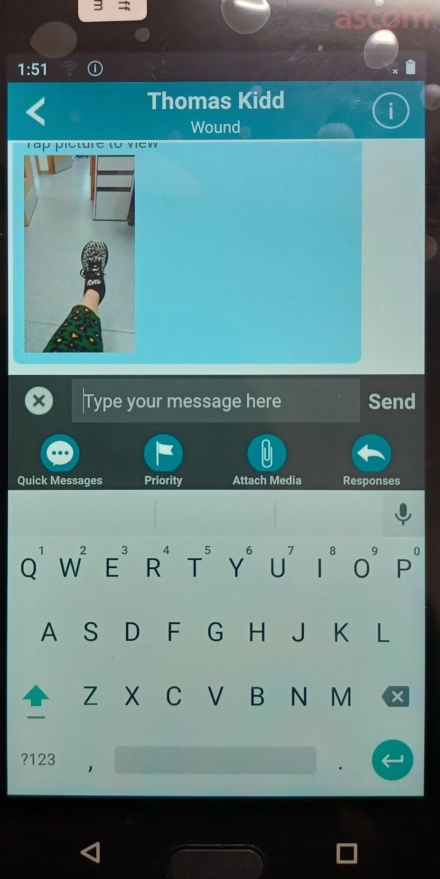
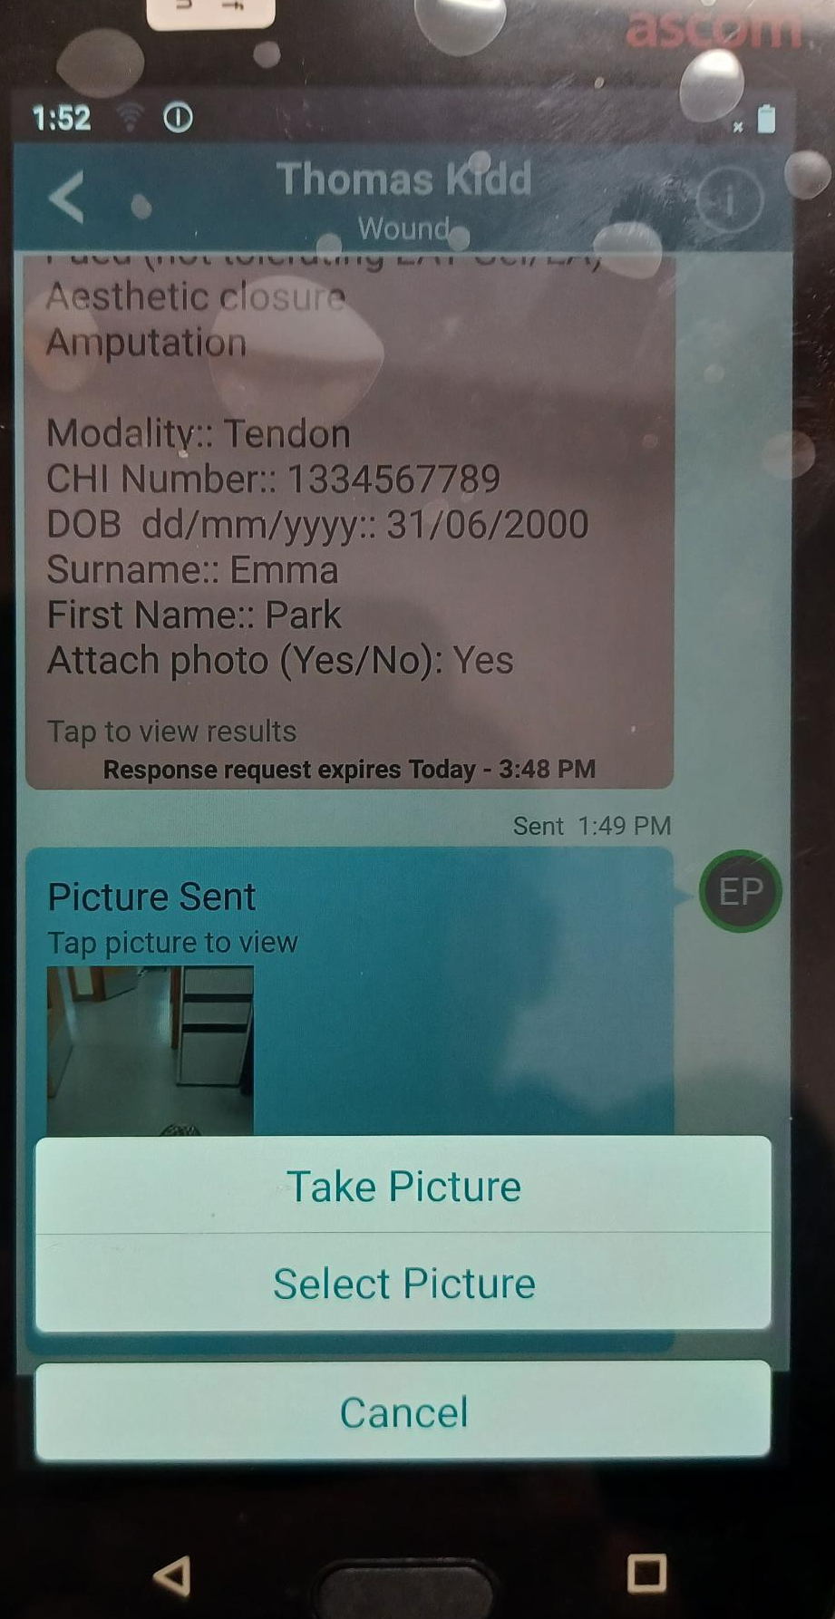
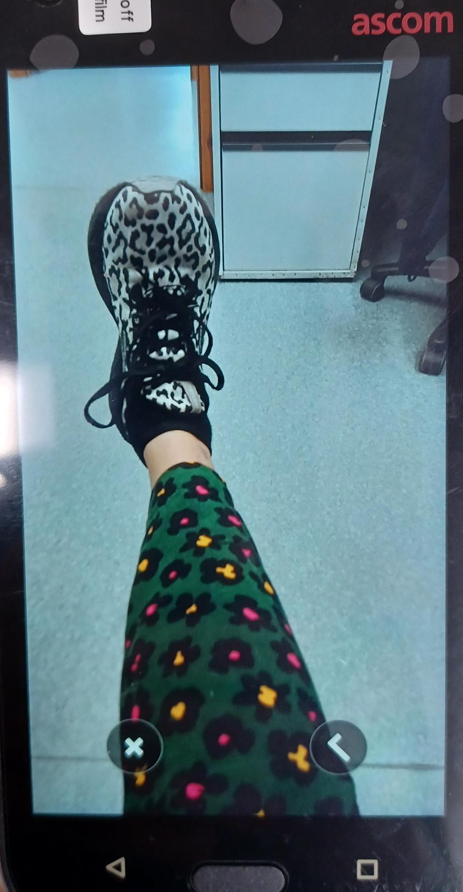
Attaching a photographic image
From the chat messaging screen select more options bottom left (3 dots)
Select ‘Attach Media’ (paperclip icon)
Select ‘Take Picture’
Select the tick icon to attach the image to the chat messaging screen
You can send more than one image in a chat

Slide 8
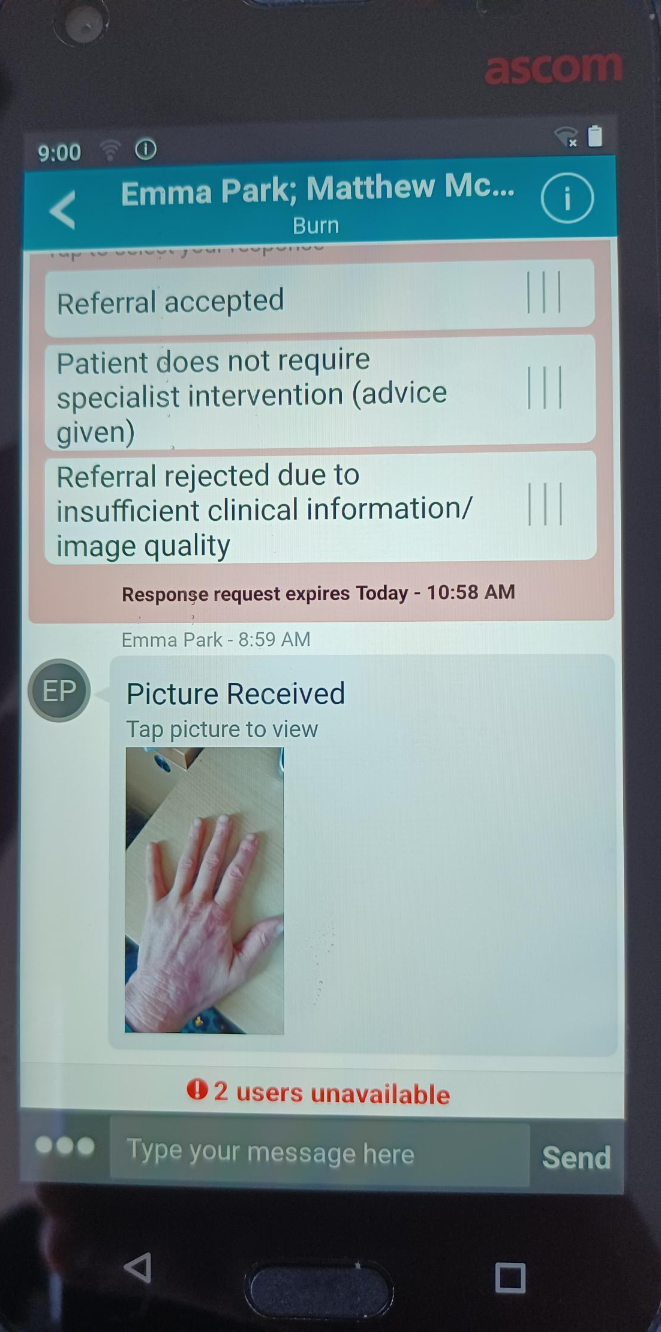
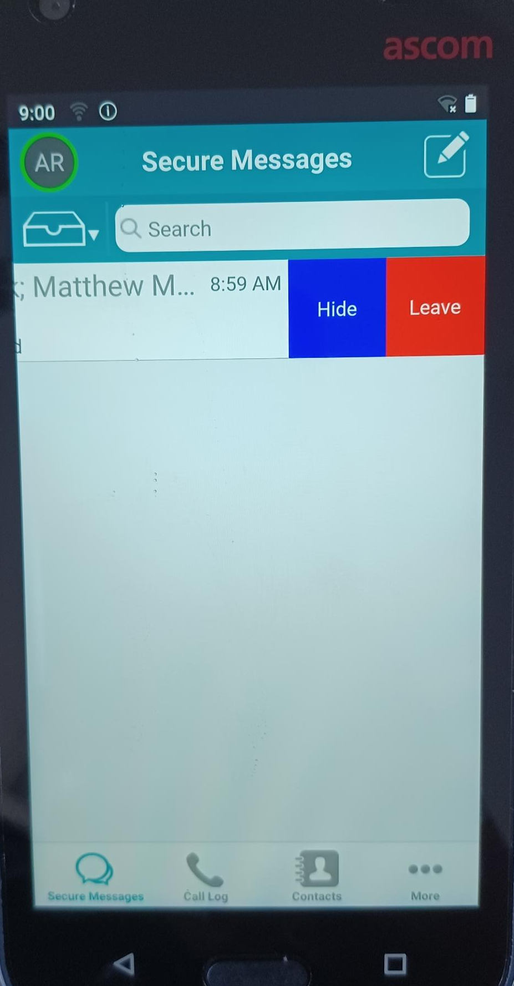
Managing chat messaging groups
New referral messages will be displayed on the app home screen in chronological order.
To read a message select by pressing the correct message on the screen
Full referral details will be displayed including any photographic images.
If you wish to send further information you can use the bottom field to send a message
Remove old messages by swiping left from the app home screen and selecting ‘Hide’ or to delete the message select ‘Leave’

