Slide 1


The Right Decision Service:
Getting evidence into action to improve health and care services
Leading quality health and care for Scotland
Notes:
Thank you for the opportunity to speak to you today about how the Right Decision Service can support HIS in getting evidence into action to improve health and care services.

Slide 2
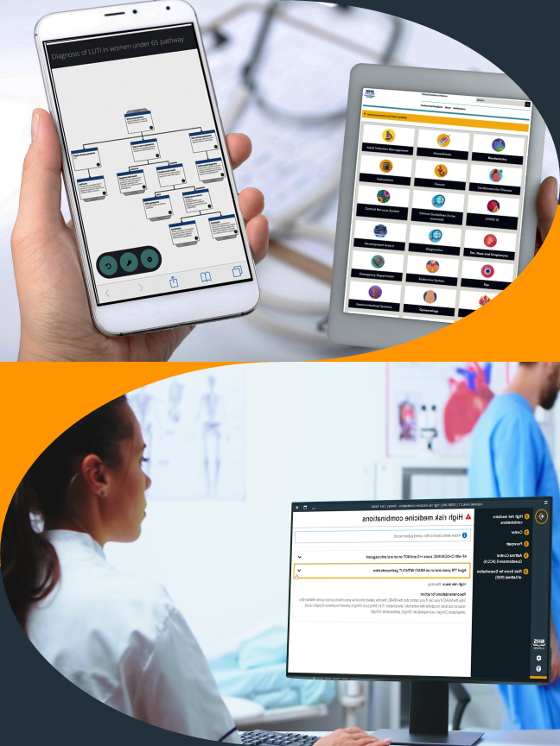
What is the Right Decision Service?
A national digital platform for decision support tools to support safe, personalised decisions.
Delivers evidence in decision-ready format to
the fingertips of practitioners and citizens :
  web and mobile apps
  prompts and alerts in care record systems
Enables people to:
  find and apply evidence
  build new decision support tools

Slide 3
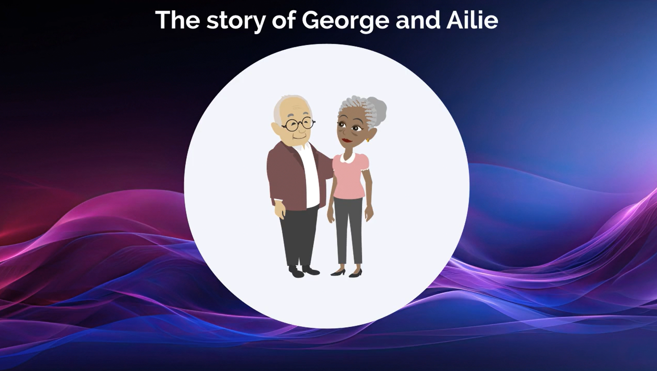
Ailie’s story
RDS supporting all partners in care and all stages of the patient journey
Notes:
To illustrate these aspects of RDS, I’d like to walk you through the story of Ailie, and how RDS supports all partners involved in her care journey.

Slide 4
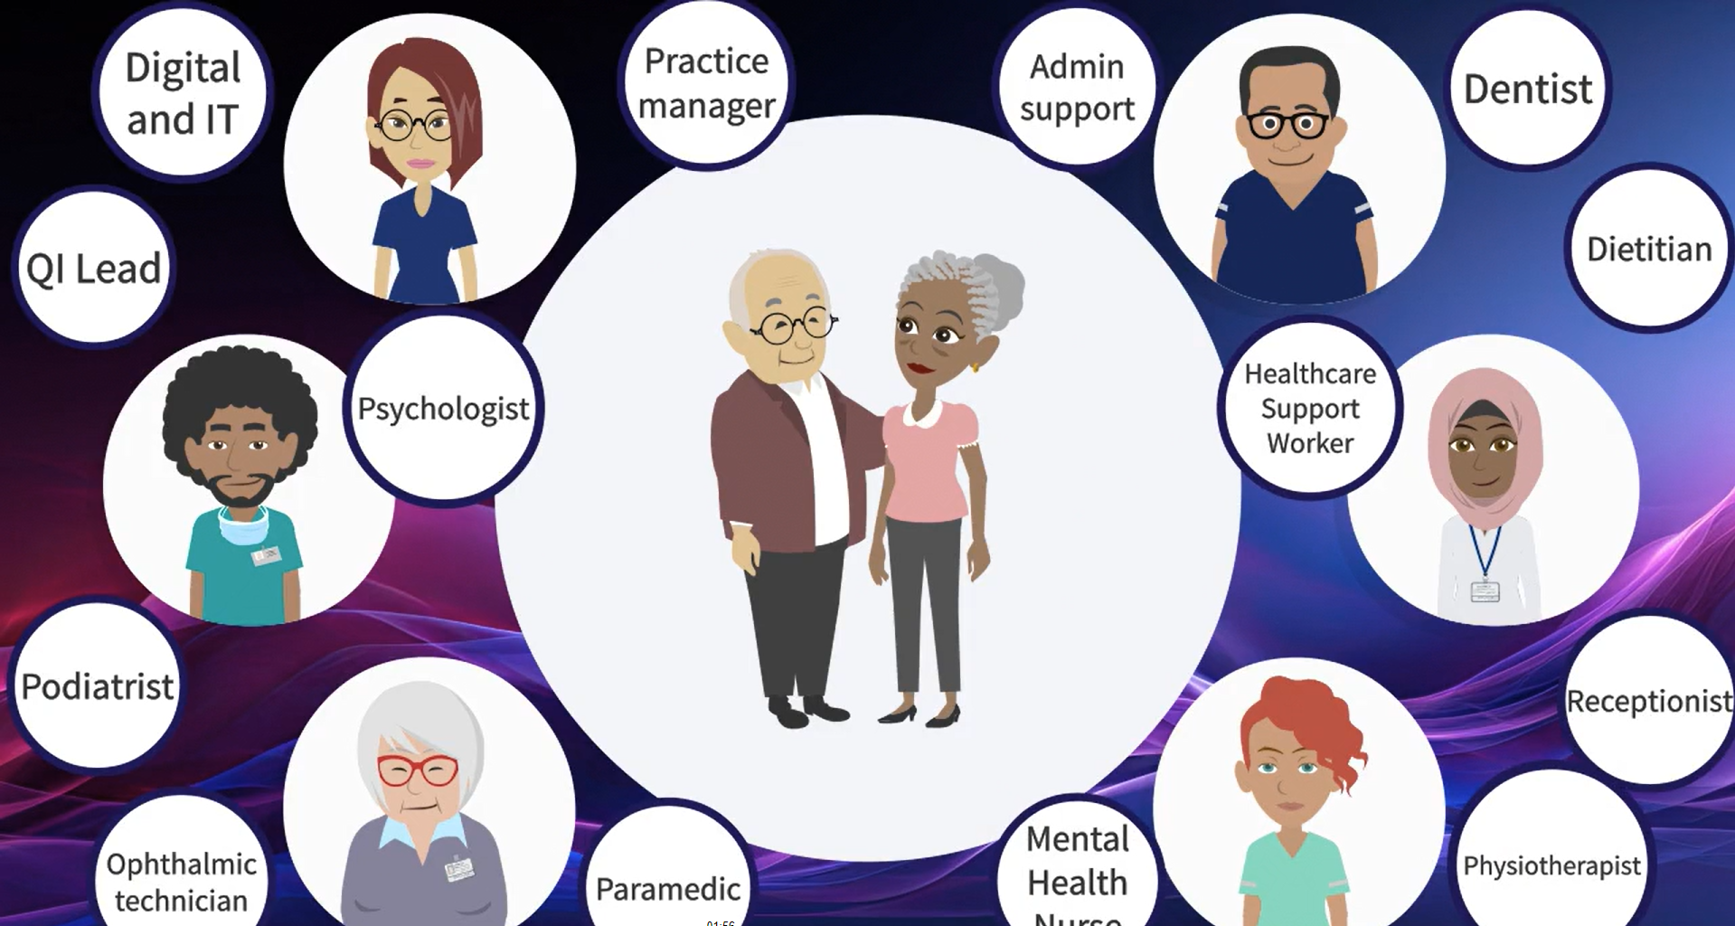
Notes:
Here are some examples of those partners – from care workers to QI leads to doctors, nurses and pharmacists.

Slide 5
Medical profiles
Ailie – 79 years old, admitted to care home 1 year ago
Partial anterior circulation stroke 5 years ago
Vascular dementia 3 years ago
Hypertension
Atrial Fibrillation 2 years
Osteoporosis
Recurrent UTIs
Hypothyroidism
Difficulty being persuaded to eat – weight loss over last year.
Large number of medications
Husband George – 81 years old, lives at home, visits Ailie every day
Type 2 diabetes, managed with metformin, diet, lifestyle
Early stages of heart failure
Anxiety and insomnia
Notes:
Ailie is a 79 year old woman who has been living in a care home for a year.
She had a stroke 5 years ago and was diagnosed with vascular dementia two years later. She has hypertension and atrial fibrillation and evidence of osteoporosis. She has recurrent UTIs and difficulty eating, with a noticeable weight loss since her admission to the care home last year. She is taking a large number of medicines for her multiple conditions.
Her husband George still lives in the family home, and visits Ailie every day. He has his own long term health issues to cope with.

Slide 6
Start of the story
Ailie has had a flu like illness for a few days.
Increased confusion, great difficulty eating and drinking.
Notes:
The care worker in the care home is concerned about her.

Slide 7

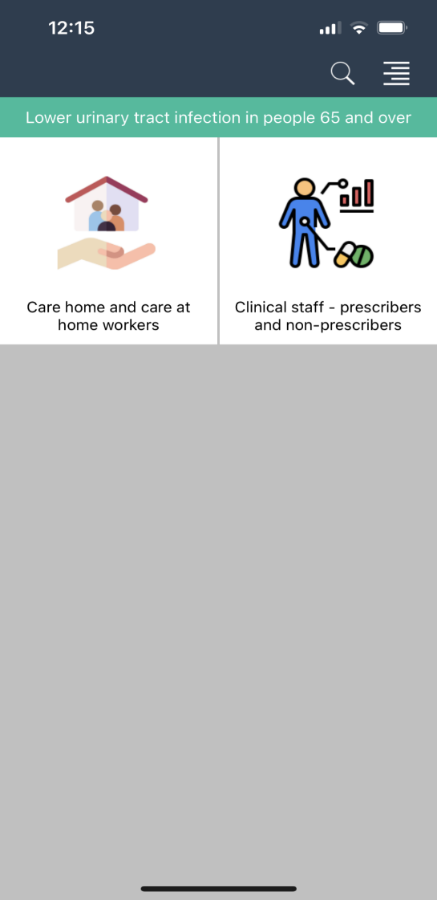
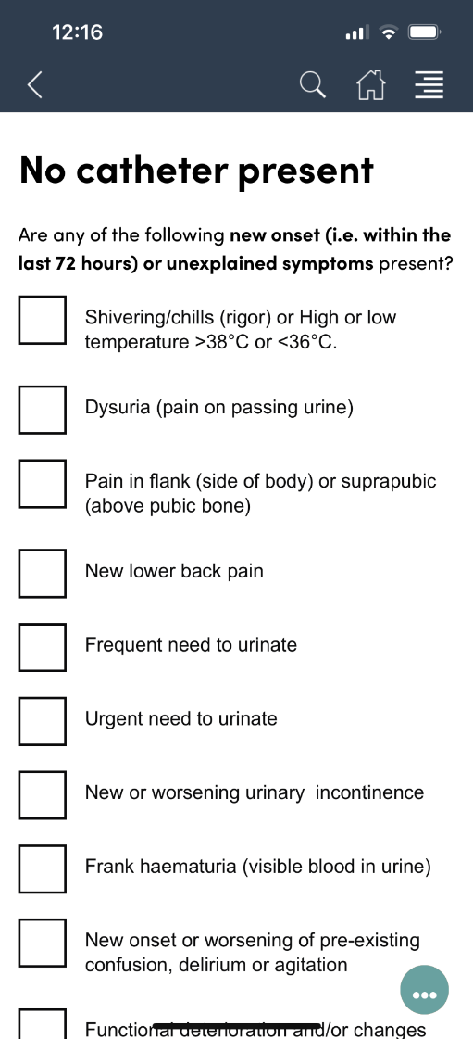
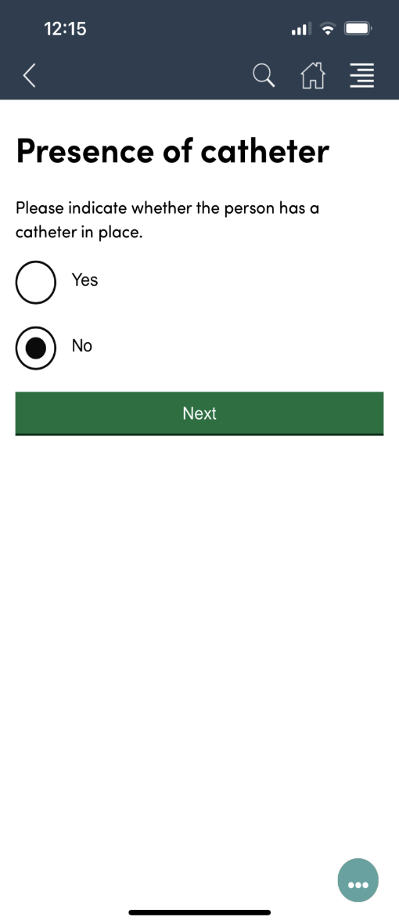
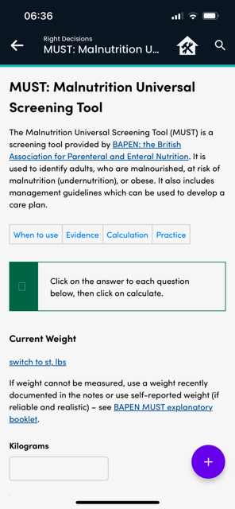
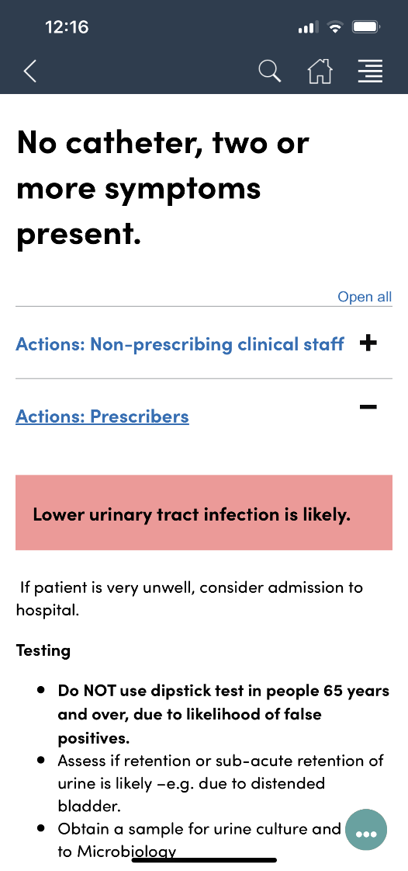

Care home worker and nurse
Notes:
The care worker has been using the MUST malnutrition universal screening tool on RDS with Ailie for some months and knows that she is already at high risk of malnutrition. So her complete stopping of eating and drinking over the past few days are a serious concern.
The care worker and one of the care home nurses also use the lower urinary tract infection assessment tool which is part of the SIGN LUTI guideline on RDS to identify that it is likely Ailie has another urinary infection.

Slide 8
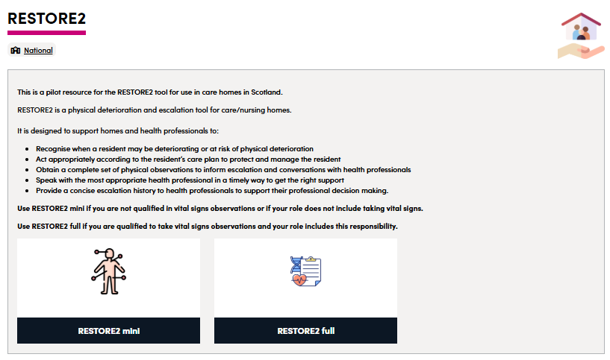
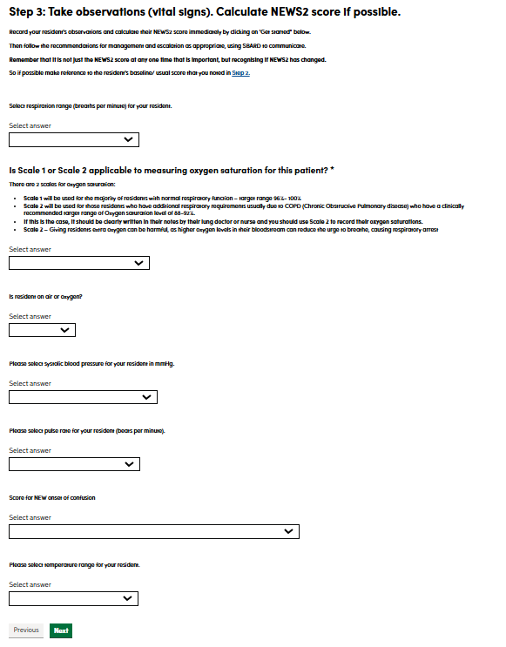
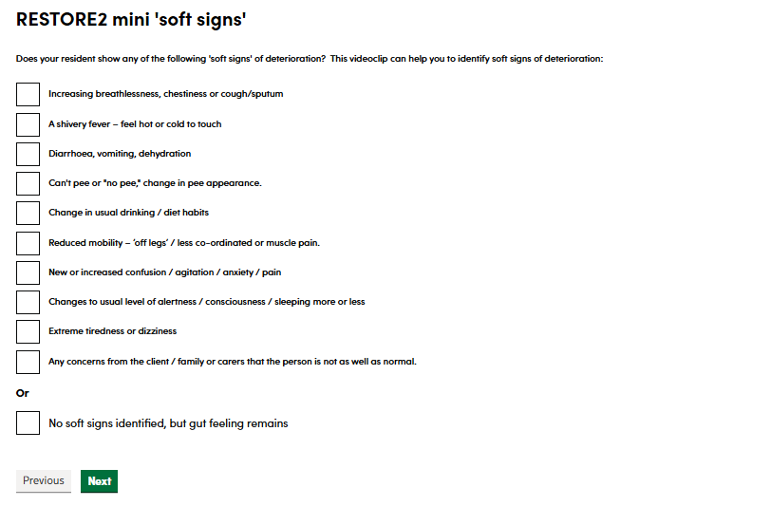
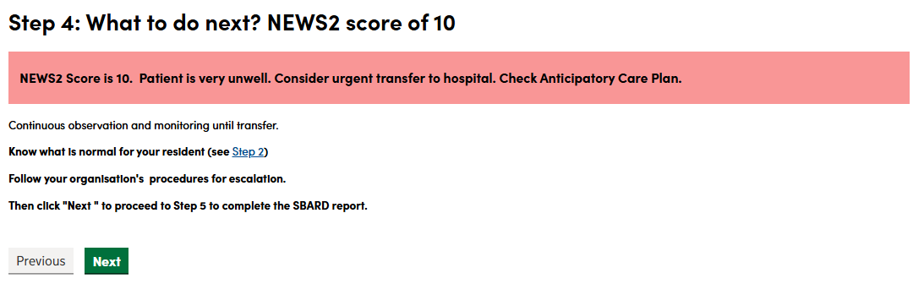
Care home worker and nurse
Notes:
The care worker has used the RESTORE2 mini tool to record soft signs of deterioration, and the nurse follows up by taking clinical observations – respiratory rate, oxygen saturation – which indicate that she is seriously unwell and admission to hospital is recommended.

Slide 9
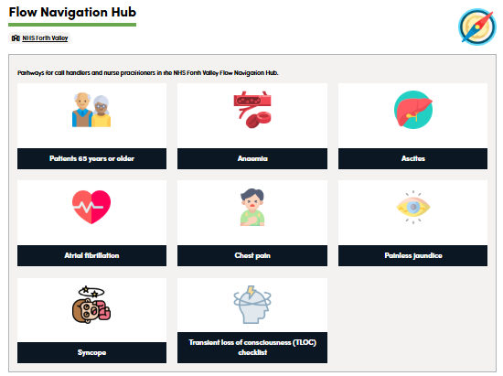
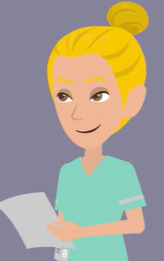
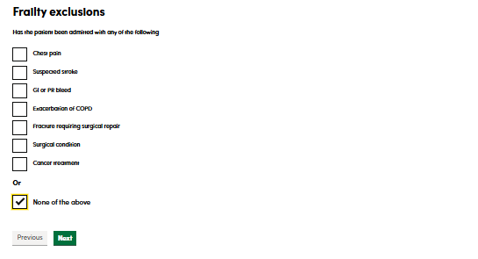
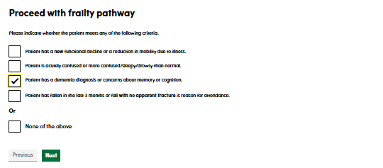
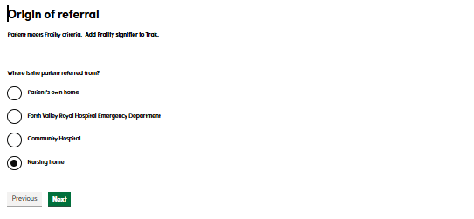
Flow navigation hub – nurses and call handlers
Notes:
The care worker and nurse call the GP and provide the observations they have recorded on the RDS. The GP calls the hospital to request admission.
The call handler and nursing team in the hospital flow navigation hub ask the GP questions using the RDS flow navigation toolkit to check whether in patient admission or other options such as same day emergency care or hospital at home are appropriate.
These screen shots show the frailty pathway questions

Slide 10
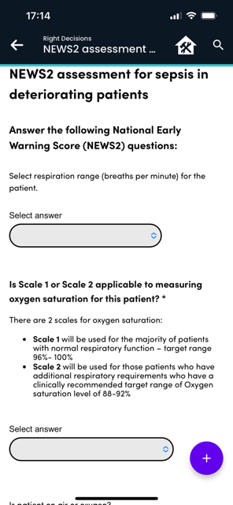
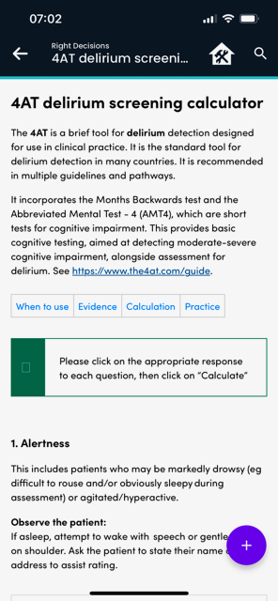

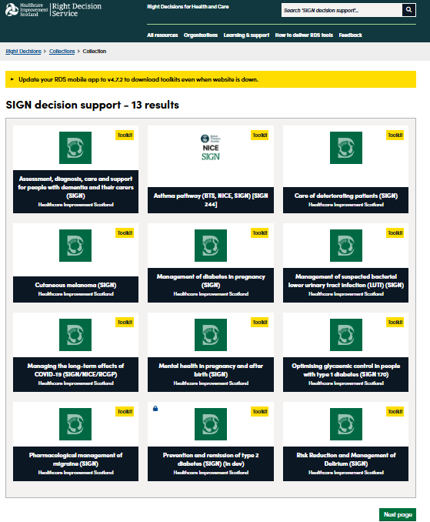
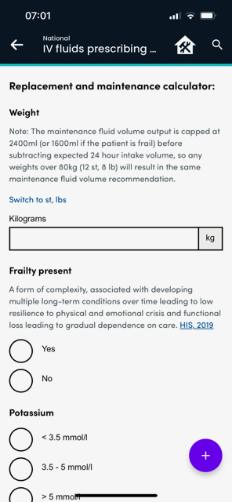
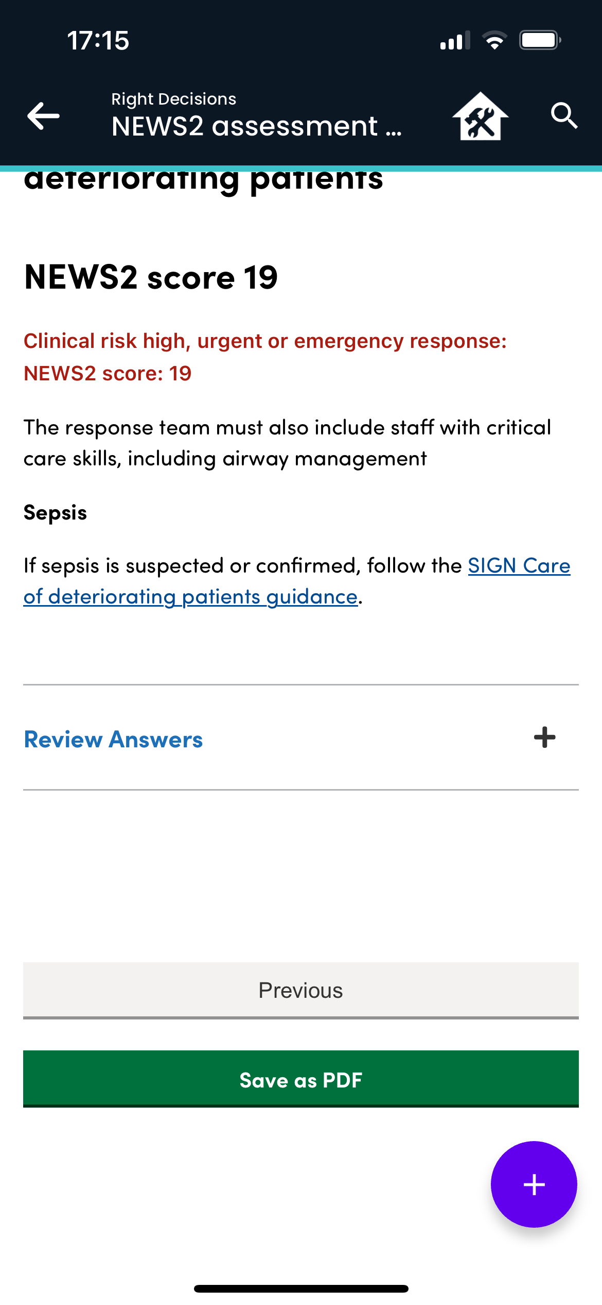
Inpatient stay – junior doctor and nurses
Notes:
Ailie is admitted to hospital, and the junior doctor and nurses who are responsible for her immediate care use a number of RDS tools to support her.
These include the RDS toolkits for the SIGN guidelines on care of deteriorating patients, dementia and delirium, and specific tools within those toolkits – NEWS2 for assessing deterioration and urgency of response needed; the 4AT tool for delirium screening and the IV fluid prescribing tool as Ailie is now severely dehydrated.

Slide 11

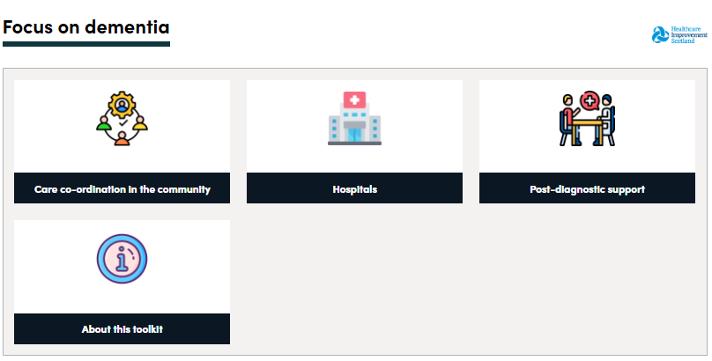
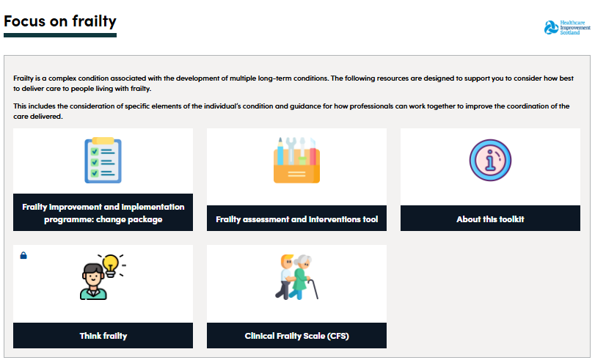
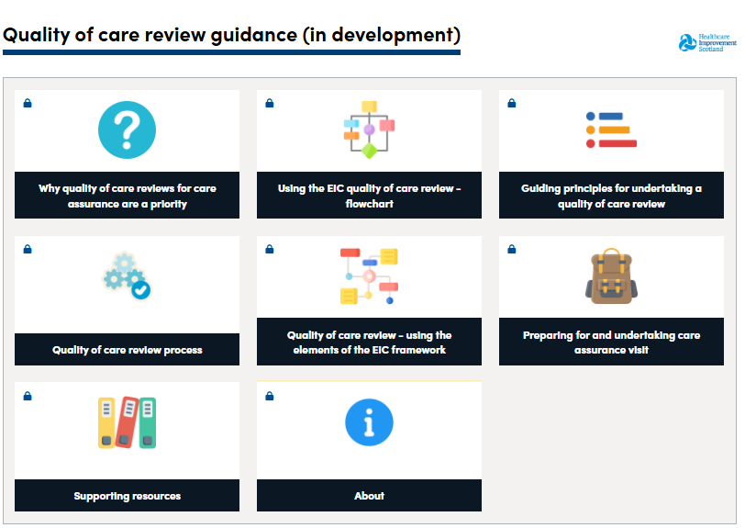
Service improvement managers
Notes:
Fortunately the ward to which Ailie is admitted has been working with HIS to improve their services for patients with dementia and frailty and the RDS toolkits have helped them to do this.
In future they may also wish to use the RDS toolkit currently under development to support quality of care reviews. This provides Excellence in Care guidance and interactive forms for recording assessments and areas for improvement.

Slide 12
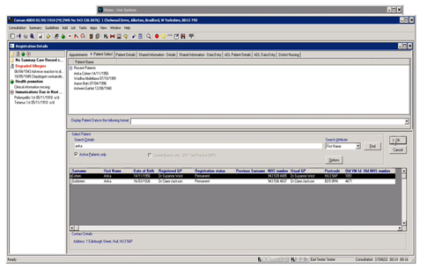
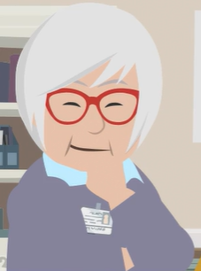
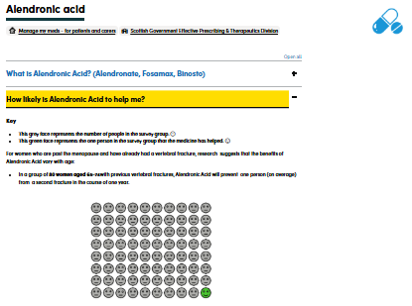
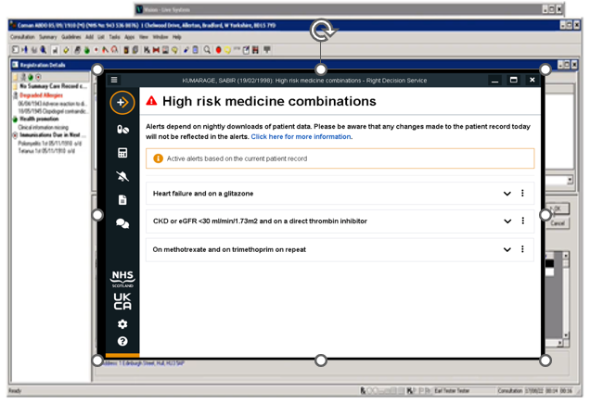
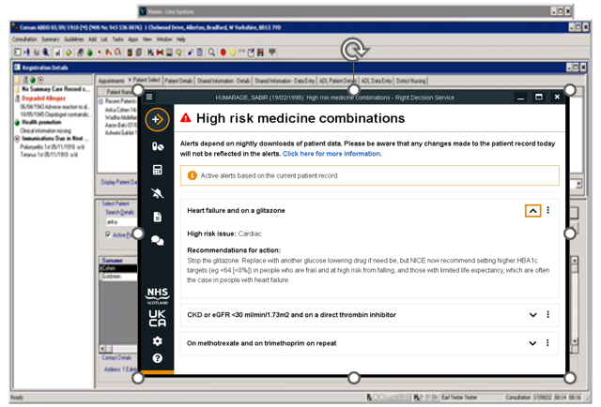

Discharge to primary care – GP & Practice pharmacist
Notes:
Ailie does recover and is discharged back to the care home. The GP and practice pharmacist arrange a medicines review to see if this might help with Ailie’s continued confusion and poor appetite. The pharmacist checks Ailie’s record on the primary care system, and the Right Decision Service highlights that she has a high anticholinergic burden which is very likely contributing to her confusion. She considers which anticholinergic medicines might be reduced or alternatives identified.
The pharmacist also uses shared decision aids on the RDS to discuss with Ailie, her husband George who is present, and the care worker, the relative benefits and risks of some of the medicines she is taking. For example, alendronic acid for her osteoporosis, which has limited benefit and can be very awkward for older people to take.

Slide 13
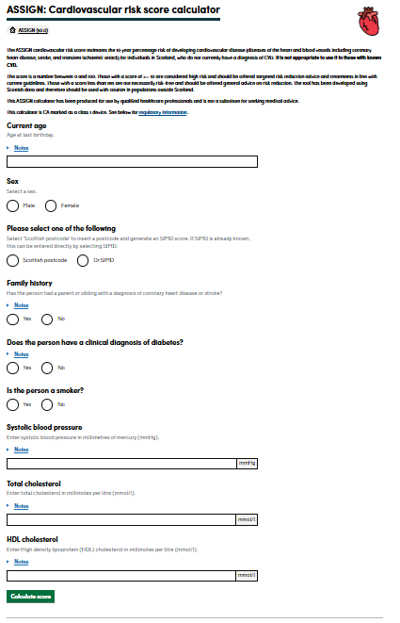
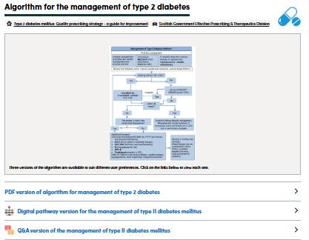
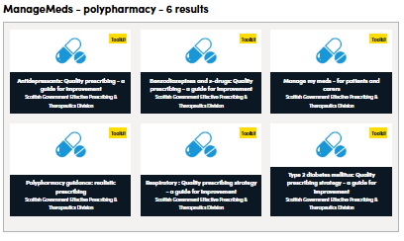
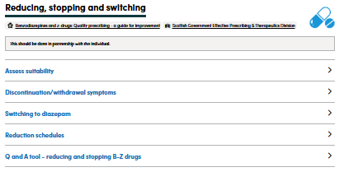
Primary care -George

Slide 14
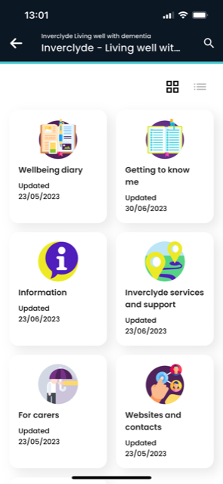
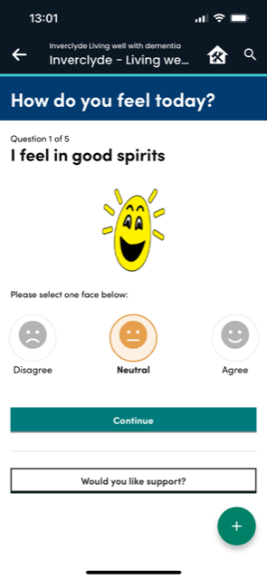
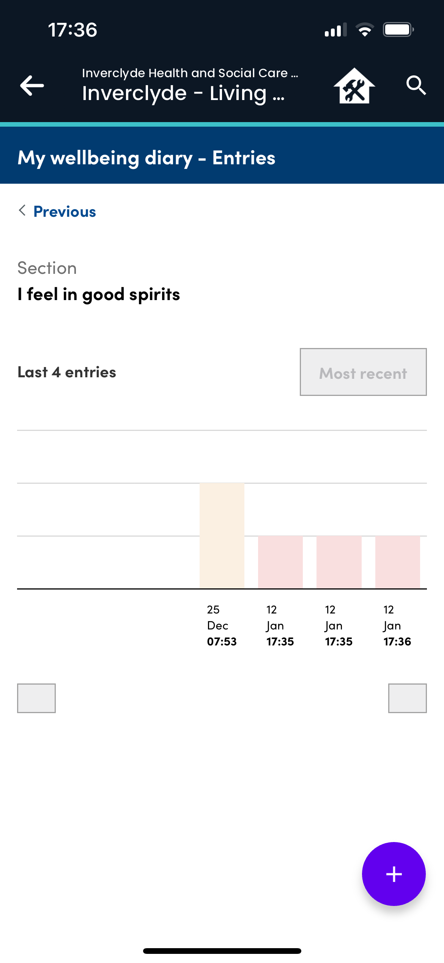
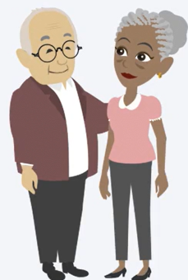
Giving Ailie and George a voice in shared decisions
Wellbeing in dementia
Notes:
The care worker in the care home also shows George and Ailie how they can use the Living well with dementia app to record changes in Ailie’s wellbeing and to alert care home staff to any pattern of decline or improvement.

Slide 15
Supporting all partners in care
Community/home
Primary care
Secondary care
Primary care
Care worker
GP
Improvement adviser
Practice pharmacist
Junior doctor
Nurse
Call handler
Notes:
In summary I hope these examples have shown how the Right Decision Service supports all partners in care, across all stages of the patient journey.

Slide 16
The Right Decision Service:
Getting evidence into action to improve health and care services
Leading quality health and care for Scotland

