Slide 1


Dalteparin to Enoxparin switch
From Tuesday 7th October 2025
Other important dates
Nurse training on wards: From 22nd September for 2 weeks
Grand round: 1st October

Slide 2
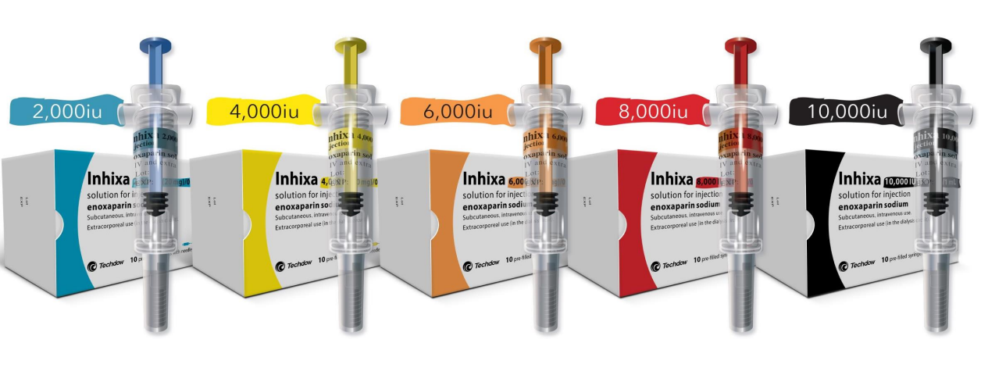
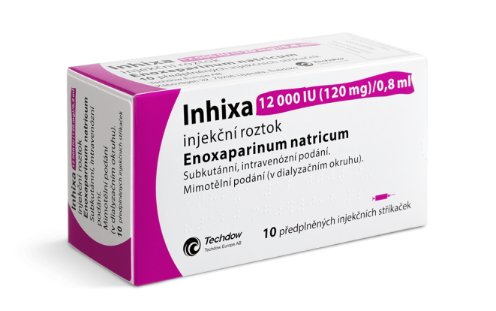
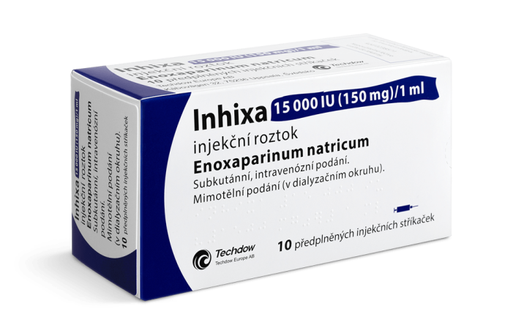
Enoxaparin (Inhixa)
20mg 40mg 60mg 80mg 100mg 120mg 150mg
Administration: same as dalteparin. Only difference is protective sleeve automatically covers the needle upon activation

Slide 3
Prophylaxis
Weight (kg) | Dosage in CrCl ≥30ml/min | Dosage in CrCl 15-29 ml/min | Dosage in CrCl <15 ml/min (including intermittent HD and CVVHD)
<50kg | 20mg ONCE daily | 20mg ONCE daily | For low to moderate thrombosis risk consider mechanical measures. 20mg ONCE daily
50-100kg | 40mg ONCE daily | 20mg ONCE daily | For low to moderate thrombosis risk consider mechanical measures. 20mg ONCE daily
101-150kg | 40mg TWICE daily | 40mg ONCE daily | 40mg ONCE daily
>150kg | 60mg TWICE daily* | 40mg TWICE daily* | 40mg ONCE daily*
*Monitoring of LMW Heparin assay (Anti-Xa) is recommended

Slide 4
Treatment
Acute VTE- excludes active cancer or high risk features
High-risk VTE
Weight (kg) | Dosage in CrCl ≥30ml/min | Dosage in CrCl <30ml/min (including intermittent haemodialysis and CVVHD)
35-46kg | 60mg ONCE daily | 40mg ONCE daily *
47-50kg | 80mg ONCE daily | 40mg ONCE daily *
51-60kg | 80mg ONCE daily | 60mg ONCE daily *
61-69kg | 100mg ONCE daily | 60mg ONCE daily *
70-73kg | 100mg ONCE daily | 80mg ONCE daily *
74-89kg | 120mg ONCE daily | 80mg ONCE daily *
90-109kg | 150mg ONCE daily | 100mg ONCE daily *
110-129kg | 180mg (100mg PFS+80mg PFS) ONCE daily | 120mg ONCE daily *
130-135kg | See Table 2 for dosing | 120mg ONCE daily *
136-165kg |  | 150mg ONCE daily *
166-200kg |  | 180mg (100mg PFS + 80mg PFS) ONCE daily *
200kg+ | Discuss with haematology
Weight (kg) | Dosage in CrCl >30ml/min | Dosage in CrCl<30ml/min
35-49kg | 40mg TWICE daily | See Table 1 for dosing
50-69kg | 60mg TWICE daily
70-89kg | 80mg TWICE daily
90-129kg | 100mg TWICE daily *
130-159kg | 120mg TWICE daily *
160-200kg | 150mg TWICE daily *
200kg+ | Discuss with haematology
*Monitoring of LMW Heparin assay (Anti-Xa) is recommended

