Slide 1


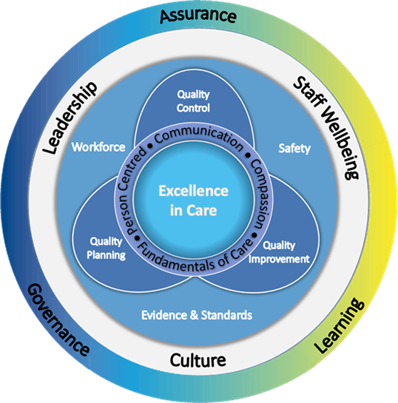

Preparing for and Undertaking Care Assurance Visits
Utilising EiC Framework
Prompts for observations/ suggested discussion points

Slide 2

Levels of Care Assurance
Peer review - across all levels
Executive / Board Level (Leadership Walk round)
Organised visits with senior leadership teams to areas with a focus on quality and safety. The aim is to connect with front line staff and provide a platform for open dialogue, mutual learning, and idea-sharing. | Clinical Area/Service (Care Assurance Visit)
 | Clinical Nurse/Midwifery Managers/ Professional Lead carry out observational visits speaking with staff, patients and relatives with a focus on quality of care. Utilising the Excellence in Care Framework to focus and articulate when improvements are needed. | Team Leader Level (Care Assurance Audit)
 |  | Senior Charge Nurse/Midwife/Team Lead carries out regular audits using local templates and or information from systems e.g. CAIR to review data and document actions and quality improvements.

Slide 3
Preparing for a Care Assurance Visit
Consider the focus of the Visit: Use the Quality of Care Review Guidance – Chapters: Guiding Principles of a Quality of Care Review, Stage 1 Scope Template and Using the Elements of the EiC Framework (even when Care Assurance Visit is a standalone process)
Board to consider if a scheduled proactive or responsive review: determine whether to be announced or unannounced for the host team
Preparation for host team: outline the purpose as part of local care assurance process, share the scope, identify who will be visiting, share date, time and duration of visit, outline what to expect and request to share information with MDT and people in receipt of care, family and visitors regarding visit
Building capacity and capability in local teams: consider the opportunity to involve peers, colleagues and aspiring leaders
Identify and consider information from previous walk rounds or reviews: Health and Safety, Infection Prevention Control (IPC), culture of the area
Consider use of other validated tools: 15 Steps, psychological safety
Care assurance visits are integral to local care assurance processes which assure high quality, safe and effective, person-centred care.

Slide 4
Undertaking a Care Assurance Visit
Engage staff at different levels, from different disciplines: promote attendance from MDT
Engage people in receipt of care and family/visitors
Observe and discuss delivery of care: using the Elements of EiC Framework to structure observations (see template to record observations/discussions)
Identify alignment between policy/best practice and your observations of care
Consider the physical environment: noise, IPC, integrity of the fabric of clinical area and equipment
Consider the Output/Summary: via professional judgement, RAG rating
Identify areas to celebrate/share, priority areas requiring support and improvement plan
Feedback to teams: consider Stage 6 of Quality of Care Review Process
Care assurance visits are integral to local care assurance processes which assure high quality, safe and effective, person-centred care.

Slide 5
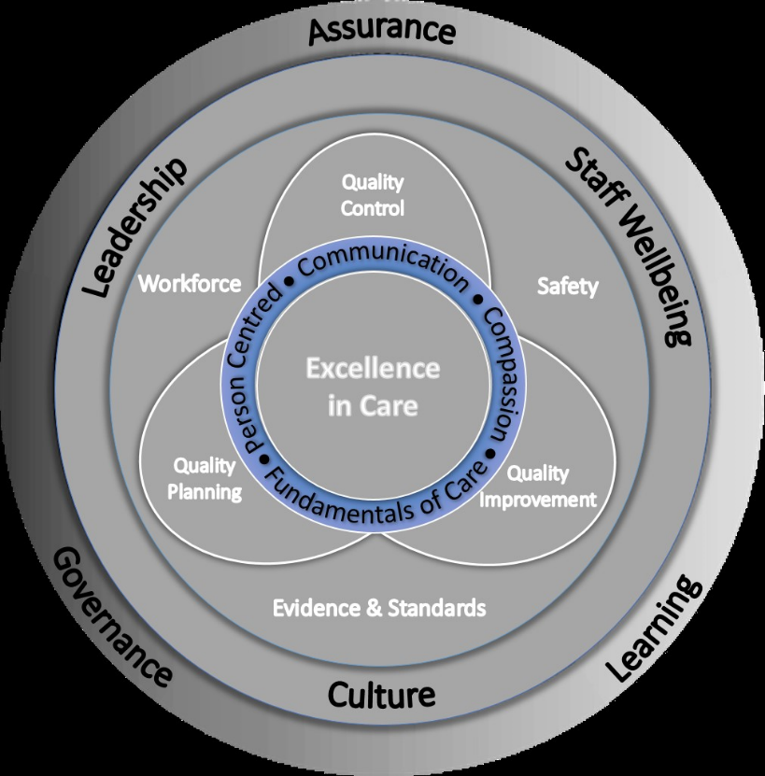
Elements of the Framework in Action
Fundamentals of Care
Quality and Safety Indicators
SPSP and CAIR dashboard data such as Inpatient Falls rate, Food Fluid and Nutrition measures, Early Warning Scores, Pressure Ulcer rates and other quality and safety indicators.
Waiting times – inpatient and outpatient services. Length of stay, number of delayed discharges.
Caseload size and complexity
GIRFEC assessment
Suggested areas for discussion/observations
Can you show me examples of documentation related to risk assessment, care planning and care delivery?
What audits do you currently undertake, how have you responded to results?
What improvement work have you identified/progressing?

Slide 6
Elements of the Framework in Action
Person Centred Care
Quality and Safety Indicators
Person-centred care plan and bundle audits (SPSP), Waiting times – inpatient and outpatient services, Length of stay, number of delayed discharges. Trauma informed care, anticipatory care planning and therapeutic indicators
Suggested areas for discussion/observations
Review examples of care planning (for example birth plan), ‘Getting to know me’/’My world assessment’ documents to see how care is individualised. Does this match with what you observe?
Can you give examples of when you have observed patients and families being treated with dignity and respect? (or not)
See questions in QoC Review Guidance or CAV Template on the EiC 5 domains of Person-centred care – personalisation, co-ordination, enablement, wellbeing and experience of care

Slide 7
Elements of the Framework in Action
Compassion
Quality and Safety Indicators
Care Opinion, Patient Experience Team, Complaints or Adverse Events, Trauma informed care.
Suggested areas for discussion/observations
How are staff interacting with person/child in receipt of care and families in person and on the phone?
How are staff interacting with one another throughout the day and during huddles/handovers?
Has there been actions from SPSP feedback to the team

Slide 8
Elements of the Framework in Action
Communication
Quality and Safety Indicators
Care Opinion, Patient Experience Team or Advocacy, Complaints, Adverse Events, continuity of care.
Suggested areas for discussion/observations
Observations of safety huddles and team handovers
Review of written escalation processes and how staff receive feedback
Relevance and updating of patient status at a glance board by the multi-professional team
Observations between staff, staff and people in receipt of care

Slide 9
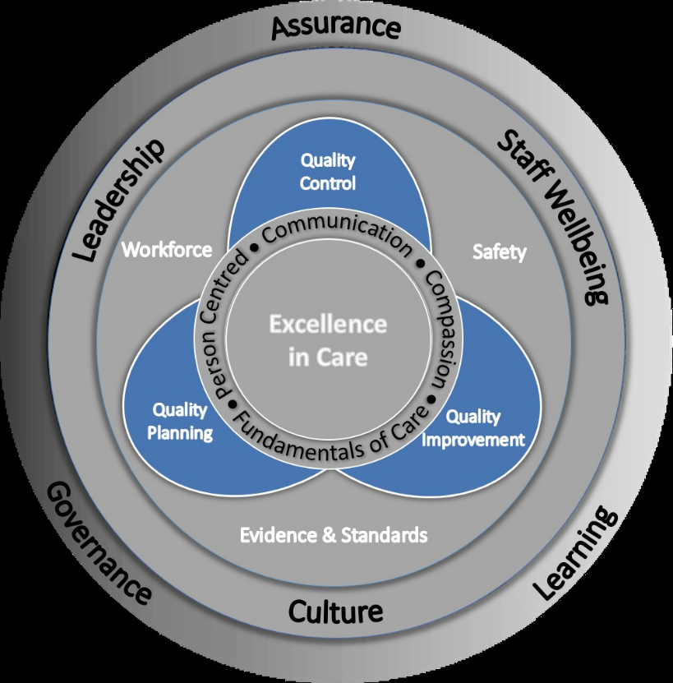
Elements of the Framework in Action
Quality Control
Quality and Safety Indicators
Monitoring performance in real time and taking action to reduce variation e.g. using SPSP and CAIR dashboard and/or data from other sources.
Suggested areas for discussion /observations
What quantitative and qualitative data does the team have access to?
How informed are the team about the data?
How are they using the data to drive improvement?
Can you see evidence of this in practice?
Are they working in a culture which enables them to make any required changes at a team level? Psychologically safe

Slide 10
Elements of the Framework in Action
Quality Planning/Planning for Quality
Quality and Safety Indicators
Choosing priorities for improvement and designing intervention to deliver improvements e.g. Using Board data for Scottish Government targets such as waiting times and/or SPSP, CAIR and local dashboards.
Suggested areas for discussion /observations
How do we know that what we are delivering meets the needs of the people receiving care?
Are the staff actively involved in service changes?
Are staff informed about the service objectives?
Which quality indicators are being used to determine improvements?

Slide 11
Elements of the Framework in Action
Quality Improvement
Quality and Safety Indicators
Small iterative tests of change to improve quality of care and outcomes. Examples of QI testing and learning.
Suggested areas for discussion /observations
What QI qualifications have staff completed within the area e.g ScLIP, SiFS, ScIL or local training programmes?
Who in the team is involved in QI work?
What QI work is happening locally?
What support is available to the team?
How is learning from tests of change communicated/shared at team level and wider?
What would staff like to celebrate?

Slide 12
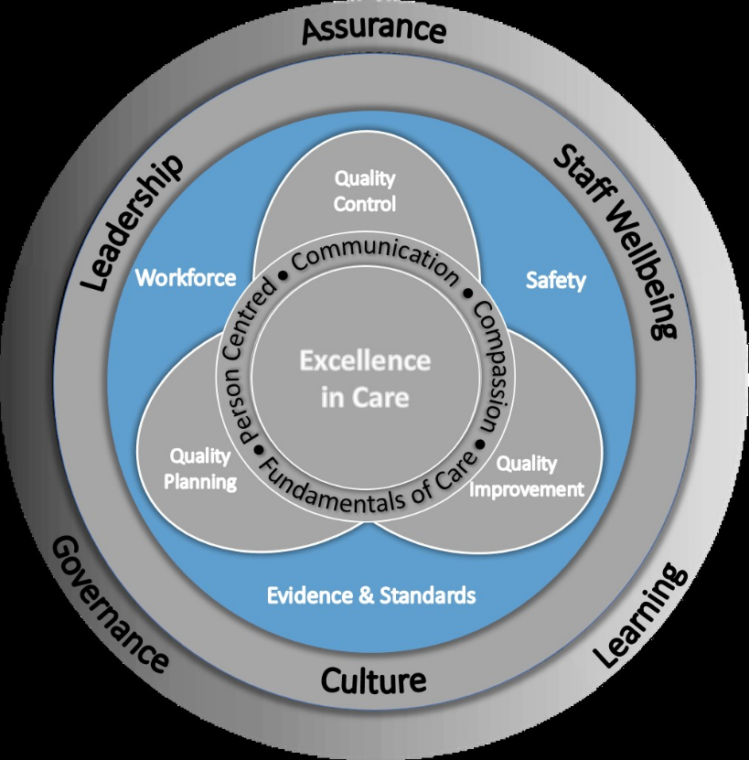
Elements of the Framework in Action
Workforce
Quality and Safety Indicators
Reviewing data from CAIR dashboard e.g. Establishment Variance, Predictable Absence Allowance and Supplementary Staffing Use (Bank and Agency/Overtime and Excess) and Data from the Staffing Level (Workload) tool run.
Suggested areas for discussion /observations
How are recurring staffing risks captured and triangulated with quality and patient outcomes / staff well-being?
Does the nurse in charge/midwife of shift identify the skill mix for safe staffing and is this being met? If not, what mitigation is in place?
Are there documented and well understood processes for how to deal with surge capacity / additional beds/complexity within caseload and caseload size?
What is observed regarding patient placement, maintenance of dignity, potential harm?

Slide 13
Elements of the Framework in Action
Evidence & Standards
Quality and Safety Indicators
Safe, consistent care is delivered by a skilled workforce utilising evidence and best practice e.g. data for Scottish Government targets, NICE and SIGN guidelines, reviewing CAIR data such as QMPLE, Professional Development and relevant registration (NMC, HCPC). GIRFEC/GIRFE/UNCRC/Pathway 4 (CfSD - Discharge without delay).
Suggested areas for discussion /observations
How are speciality specific standards used within the service?
What are the local processes for raising awareness of updated standards / best practice?
Is there evidence that feedback from pre-registration students is acted upon?

Slide 14
Elements of the Framework in Action
Safety
Quality and Safety Indicators
Paramount to the delivery of quality care, combining the reduction of risk and unnecessary harm while maximising the successful implementation of care e.g. utilising data from SPSP and CAIR, reviewing incident reporting systems, Care Opinion, Patient Experience Team, Complaints, Use of Mental Health Act – restraint, covert medication, capacity.
Suggested areas for discussion /observations
What audits are undertaken to ensure Infection Prevention and Control Procedures are in place?
Are procedures for safe administration and storage of medicines observed?
Is there evidence of Real Time Staffing and escalation processes being followed?
Are staff aware of complaints raised and any learning highlighted?

Slide 15
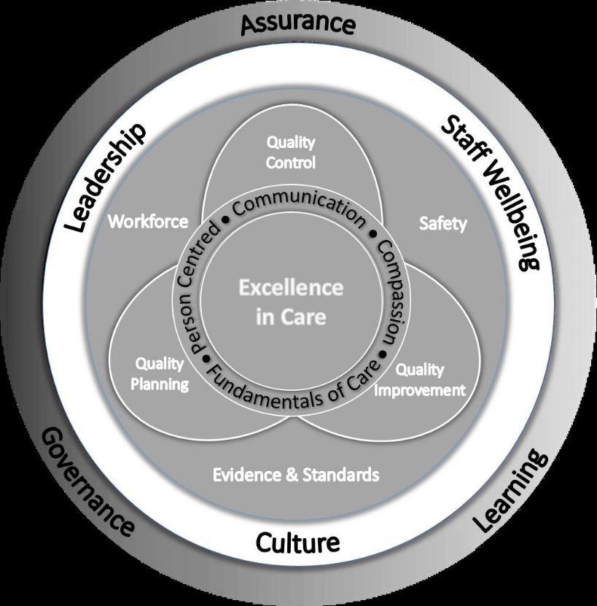
Elements of the Framework in Action
Leadership
Quality and Safety Indicators
Importance of co-designing improvements to co-produce the outcome with people in receipt of care and the team who deliver it e.g. Time to Lead and completion of training and appraisal.
Suggested areas for discussion /observations
What protected leadership/management time is available (agreed as per local governance arrangements) and how is it utilised? If unable to protect the agreed leadership time, then risk and mitigations should be recorded
Are one to one/supervision/opportunities made available to staff?
Is current workload and any support requirements discussed at the huddle?
Are annual appraisal completed in a timely manner?

Slide 16
Elements of the Framework in Action
Culture
Quality and Safety Indicators
Impacts staff wellbeing, patient safety, embedding quality improvement, NES Safety Culture Cards and innovation in day-to-day practice e.g. Staff feedback such as iMatter, Joy in Work and information from previous reviews. Appraisal and Staff professionalism.
Suggested areas for discussion /observations
What areas of professionalism do you observe?
Are teams encouraged to problem solve and innovate within clear boundaries?
Is psychological safety evident- do people express concerns openly?

Slide 17
Elements of the Framework in Action
Staff Wellbeing
Quality and Safety Indicators
Essential for the delivery of compassionate, person-centred care e.g reviewing CAIR -Predictable Absence Allowance, Establish Variance measure, iMatter, Joy in Work and TURAS - Appraisal and Training
Suggested areas for discussion /observations
Do staff feel supported by their immediate team and wider leadership and know where to go for support on both clinical and operational issues?
Are there clear lines of delegation for decision making with clear lines of escalation for issues?
Do staff get their breaks? What are their break facilities like?
What wellbeing activities are readily available for staff ?
Do the team undertake de-brief activities after particularly challenging periods / episodes of care delivery?
Application of NHS Scotland Workforce Policies

Slide 18
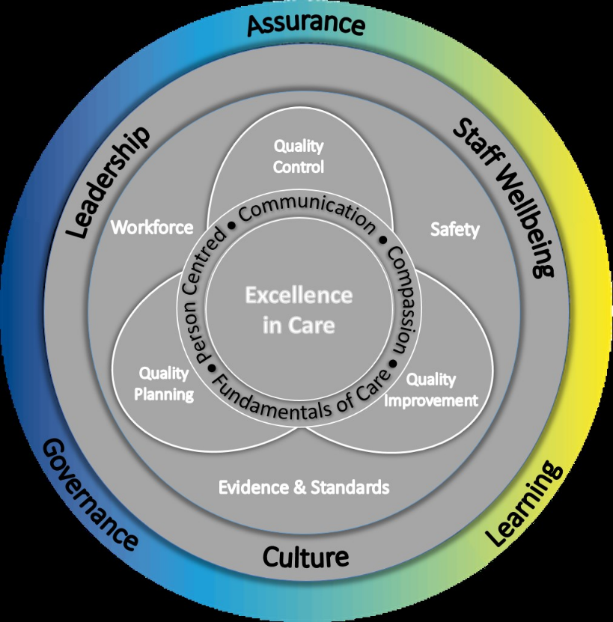
Elements of the Framework in Action
Assurance
Quality and Safety Indicators
Verifying whether the team/system have effective approaches to managing quality of care e.g Local dashboards
Suggested areas for discussion /observations
What local systems do you use that currently provide assurance?
Who undertakes local assurance processes?
Is the frequency of assurance processes sufficient to pick up early signals within the system?
Is the scope of local assurance processes sufficient to meet your needs? Consider the domains of care quality- patient experience, safety, effectiveness, efficiency, sustainability.

Slide 19
Elements of the Framework in Action
Governance
Quality and Safety Indicators
Shared governance emphasises the perspective of staff, shared decision making and professional accountability therefore aligning governance with culture and staff wellbeing e.g risk Assessment and escalation processes and visible and effective governance. Child protection/Adult support and protection.
Suggested areas for discussion /observations
Are there standardised risk escalation processes and are they effective?
Is there a feedback loop for staff who have escalated risk?
Who reviews quality and workforce measures for this service?

Slide 20
Elements of the Framework in Action
Learning
Quality and Safety Indicators
Consider if there is evidence of a culture of continuous learning across the system e.g. Clinical Supervision, Appraisal and Training and QI qualifications within the area such as ScLIP, SiFS, ScIL or local training programmes, Hot/Cold debriefs, Protected learning time and TURAS learning.
Suggested areas for discussion /observations
How do the team/wider system share learning from adverse events/incidents, near misses, positive care experiences?
What opportunities are there to access Clinical Supervision, Values Based Reflective Practice sessions, other methods of supporting reflective practice?
Opportunities to access training- statutory mandatory, role specific and training linked to areas for improvement?
What communities of practice/networks/local events do team members have the opportunity to exchange learning in?

